Slide 1
Memories
of the
Peacemaker Event
September 27, 2023
Matilda Wokie Parker’s
Visit To
Crocker, Missouri

Slide 2
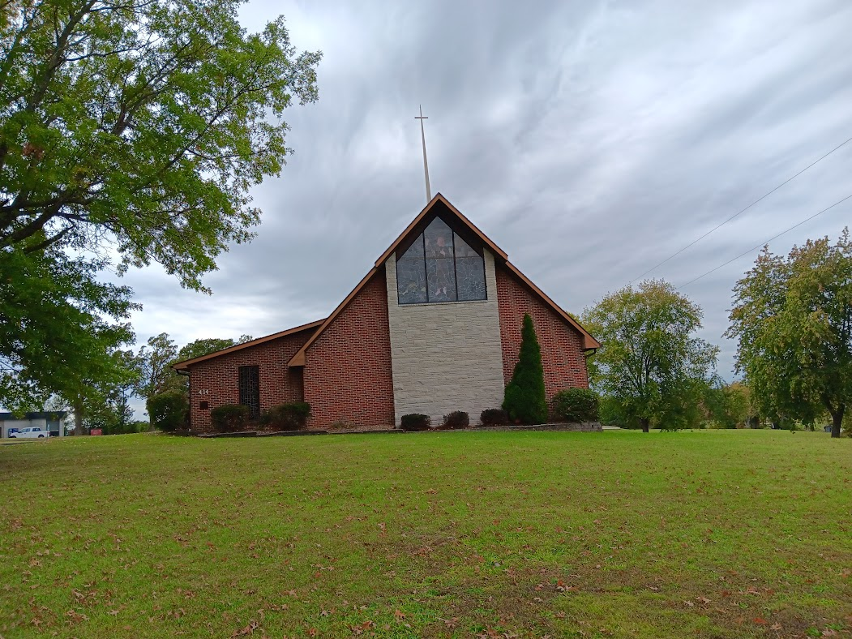
Crocker Presbyterian Church
414 S. Commercial St.
Crocker, Mo 65452

Slide 3
Jim and Linda Holt graciously transported Matilda Parker from the Springfield area to Crocker. Their trip to our community was slightly eventful when they were held up on Interstate 44 due to a traffic accident. Thankfully, everyone arrived safe and sound.
Upon arrival at our church, they were given a brief tour of our Sanctuary.

Slide 4
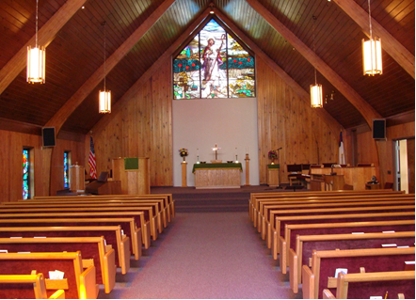

Slide 5
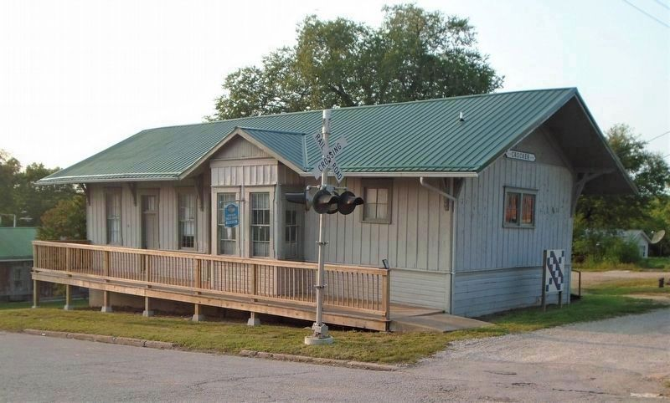
First stop- Crocker Railroad
Depot Museum which
Houses 100+ years of
Historical items/objects
of Crocker.

Slide 6
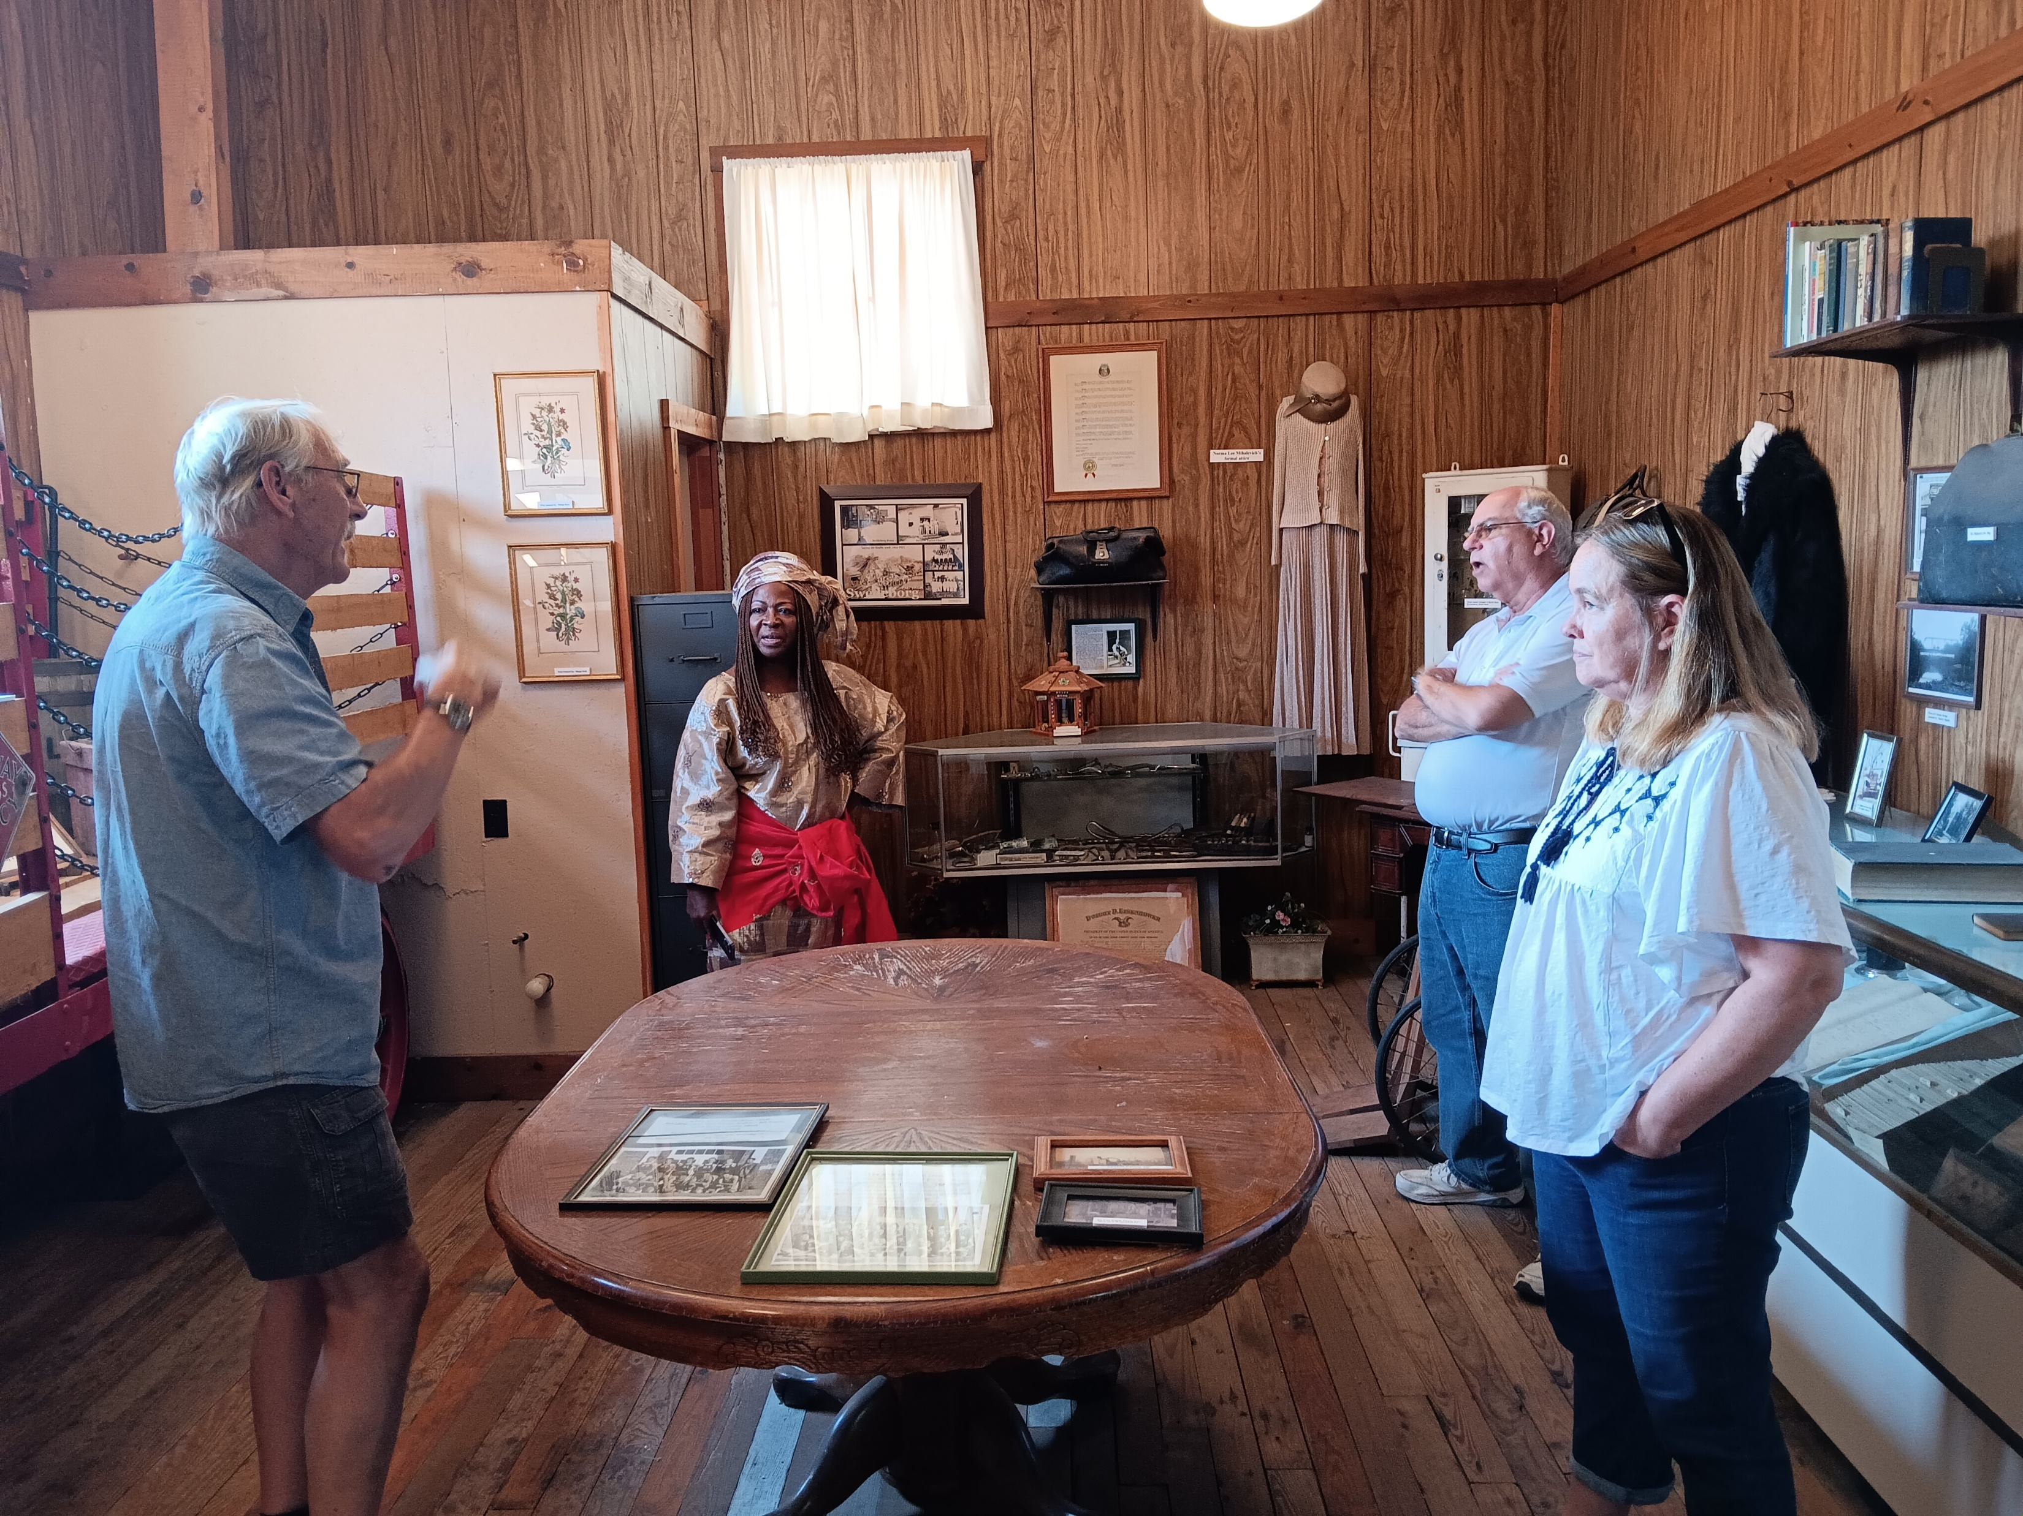
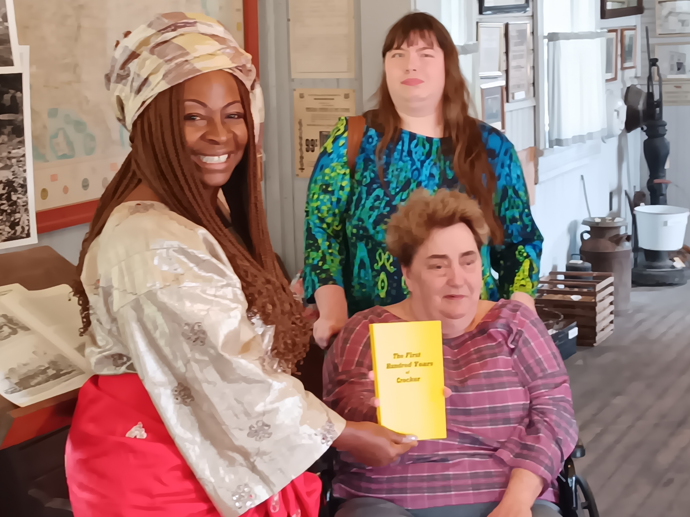
Left to Right-Lonnie Garrett Museum
Curator, Matilda W. Parker, Jim Holt
and Linda Holt.
Left to Right-Matilda W. Parker, Katelyn Fraski and Debbie Fraski. Book presentation to Matilda of the First 100 Years of Crocker.

Slide 7
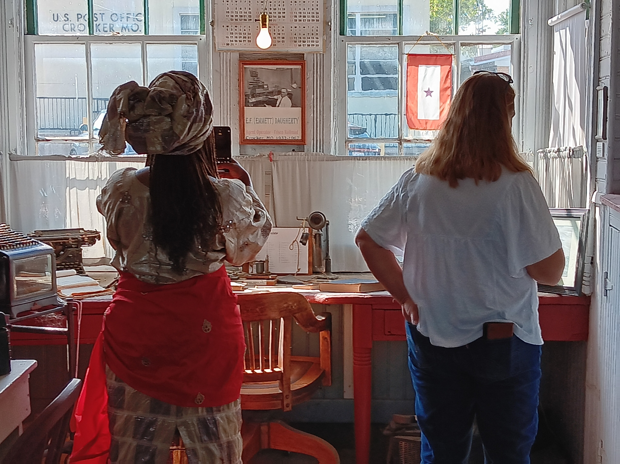
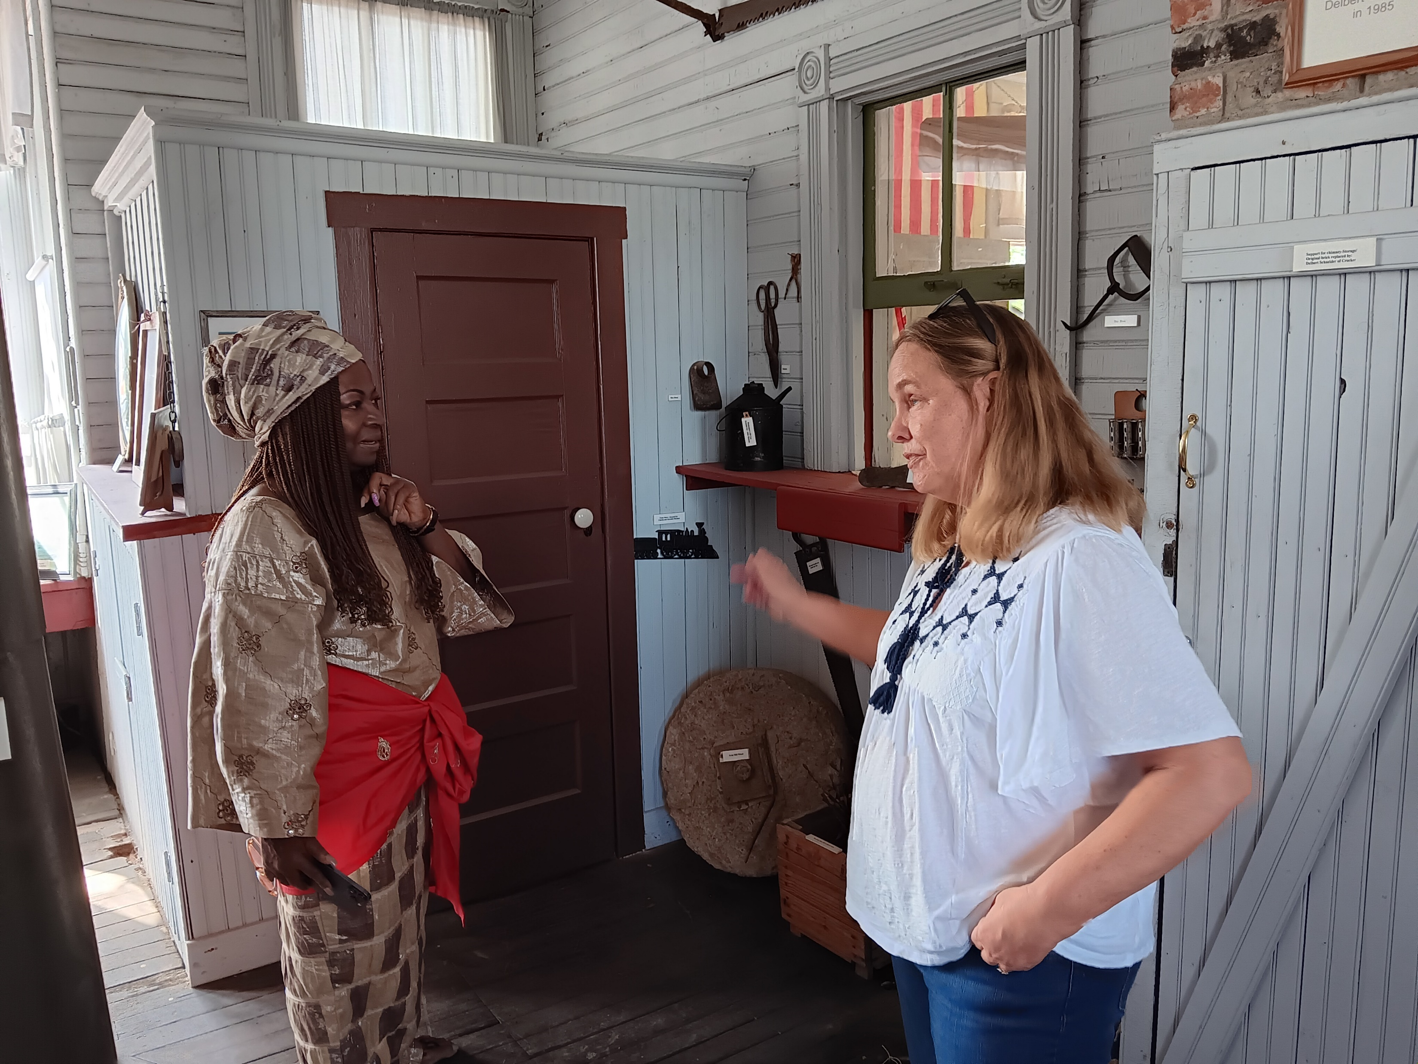
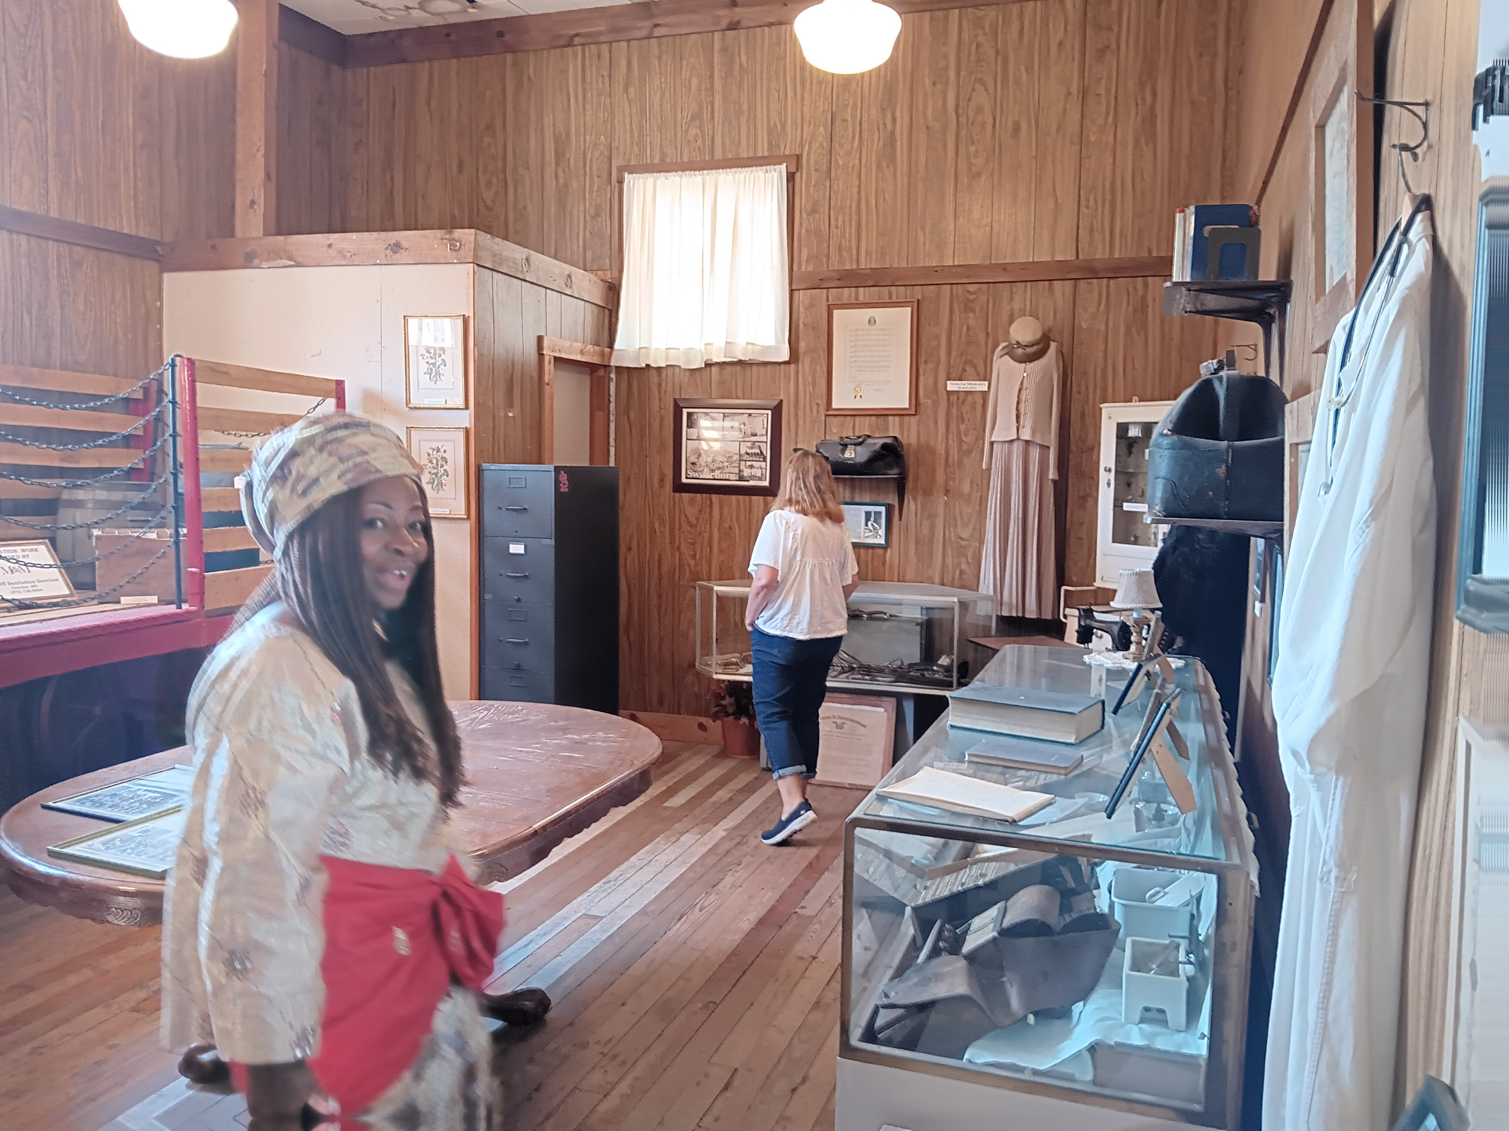
Matilda and Linda Holt
Viewing items inside the Museum while Listening to Lonnie Garrett telling
Stories about each item.
Matilda leisurely looking at each item inside the building. Everyone seemed to have an enjoyable experience.
Matilda taking a picture of the Frisco Telegraph Operator at his Desk.

Slide 8
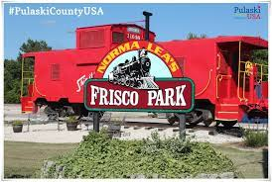
The above Caboose was given to the City of Crocker as a gift. The Caboose was part of the first train that traveled through Crocker. Crocker volunteers recently restored the appearance of the train car with a fresh coat of paint.

Slide 9
The second stop on our tour was Crocker City Hall which houses our City Utilities and City Court Room. Since Matilda’s country of Liberia is modeled after the Government of the United States, we thought it would be nice to see our small-town City Government, Court Room and Police Force.

Slide 10
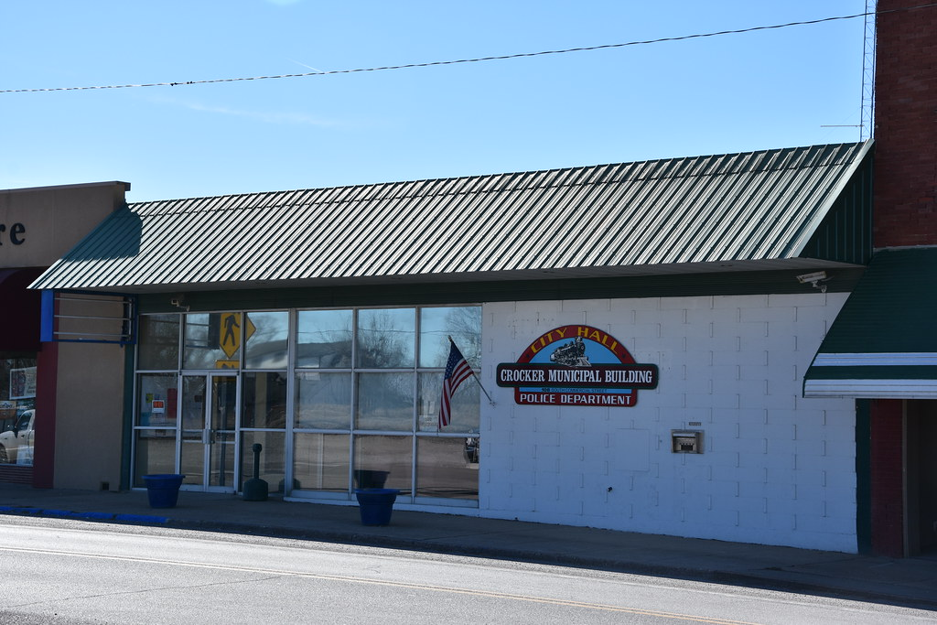

Slide 11
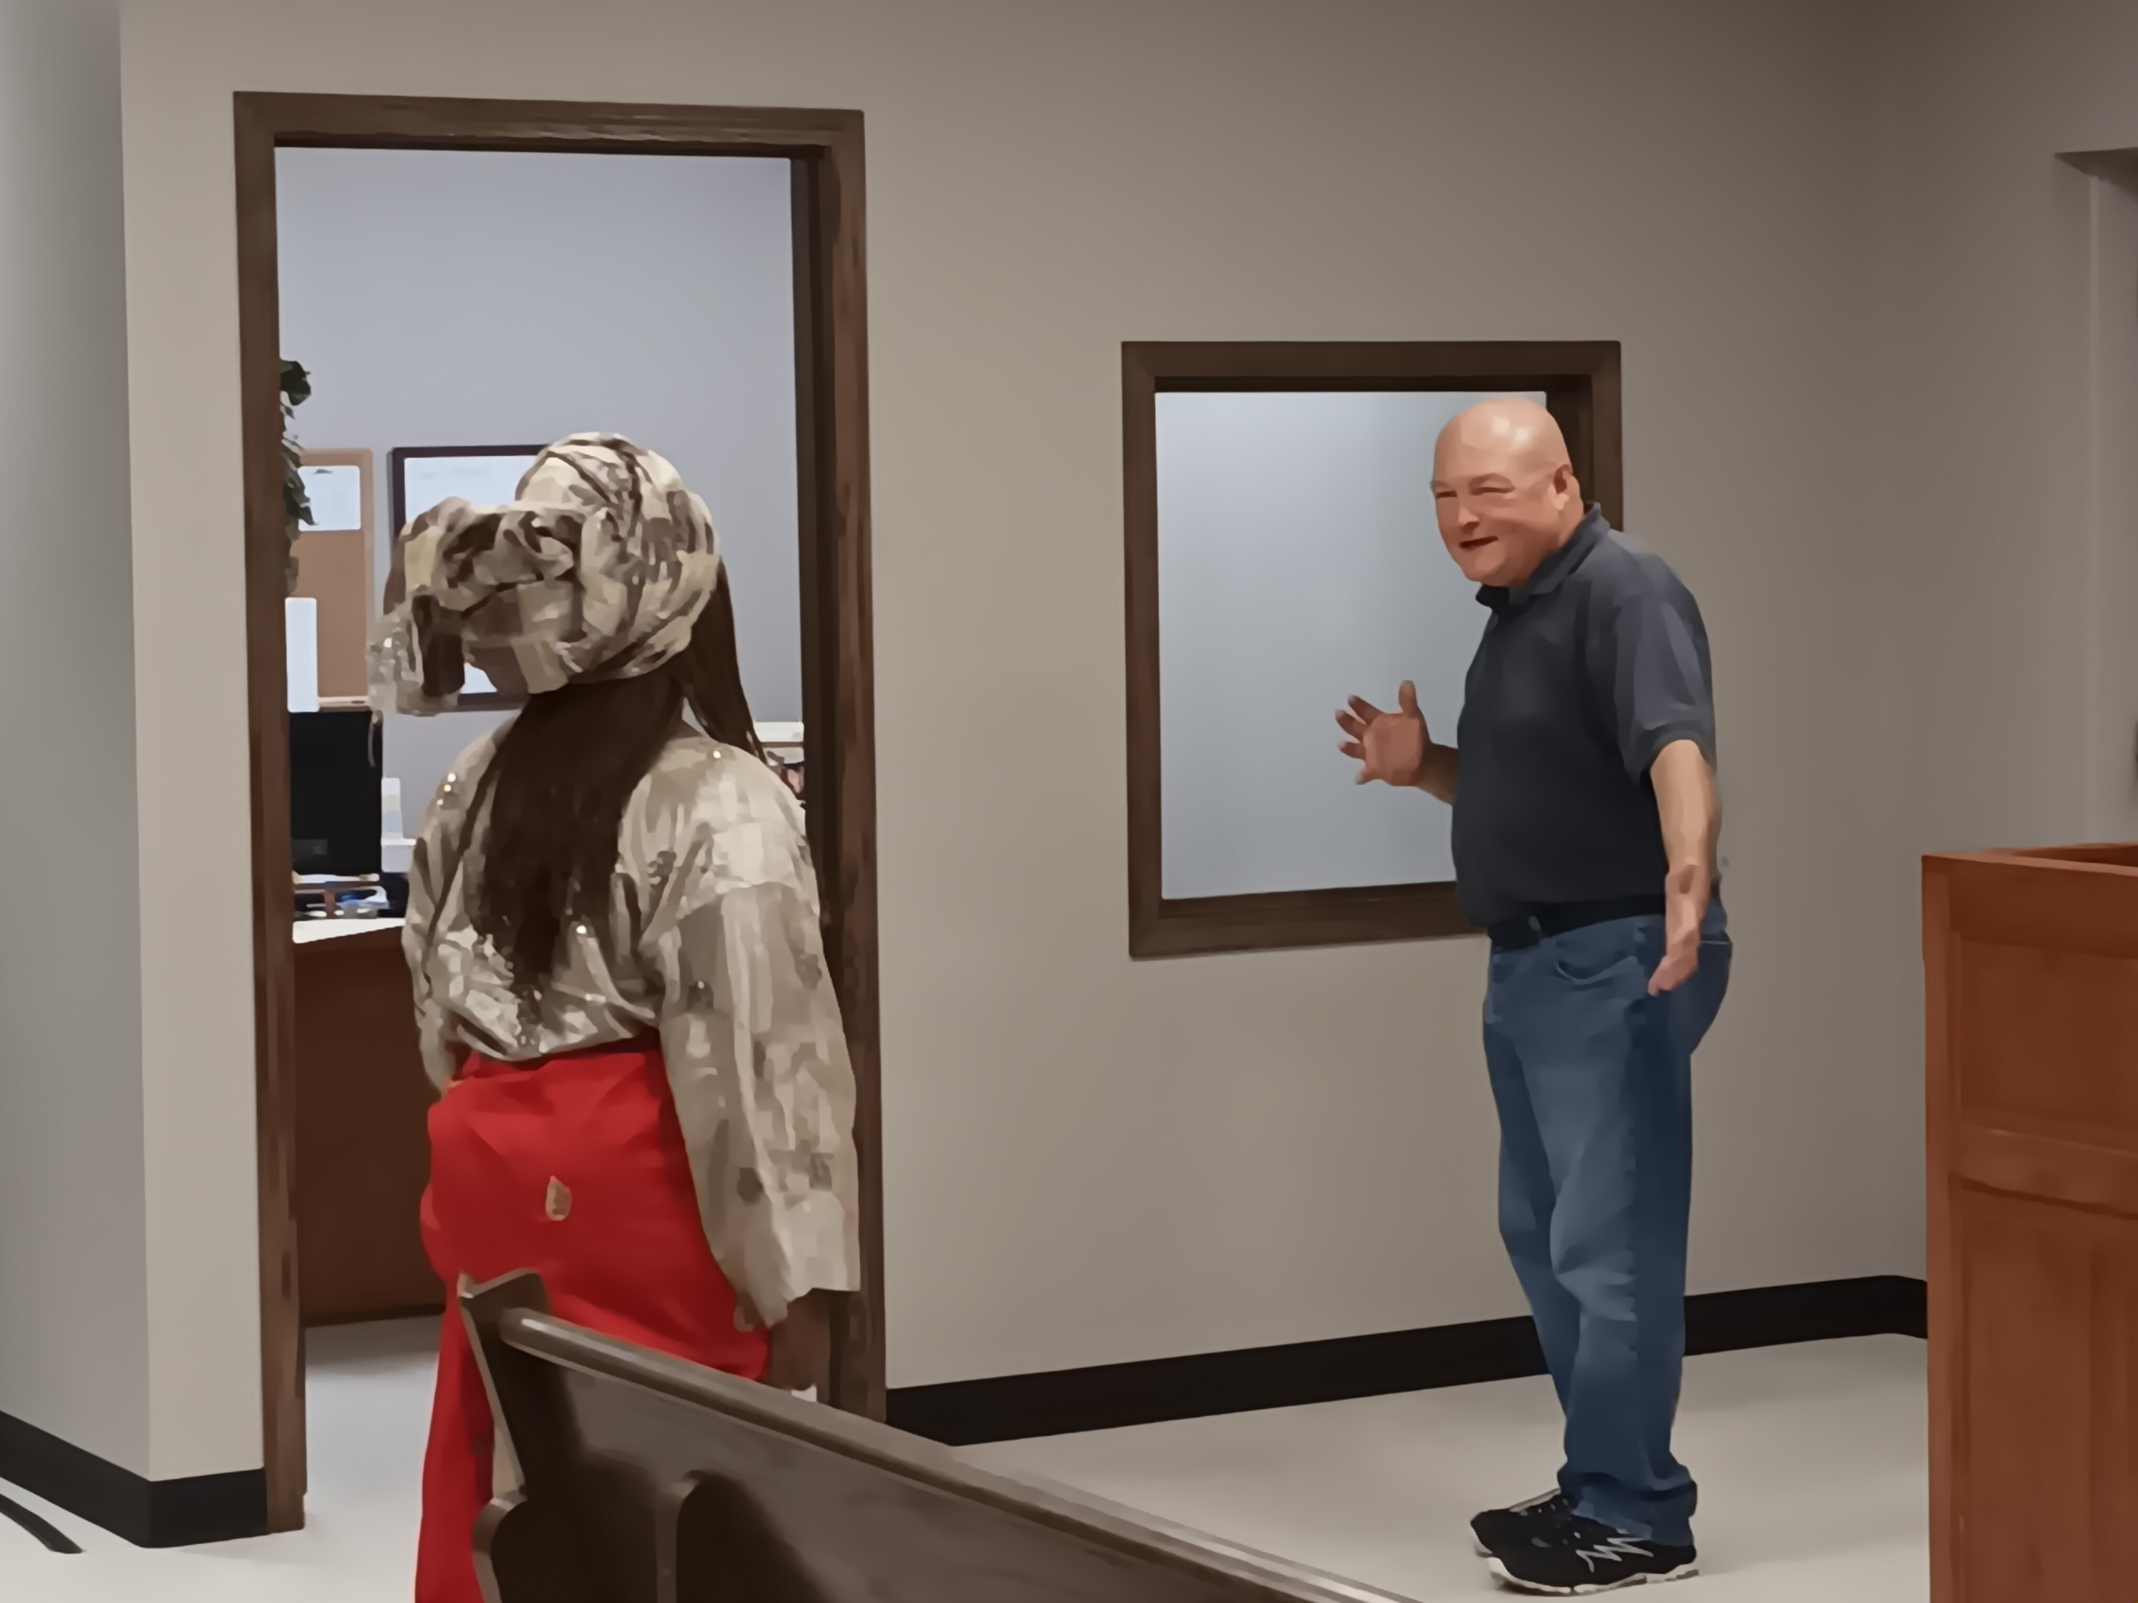
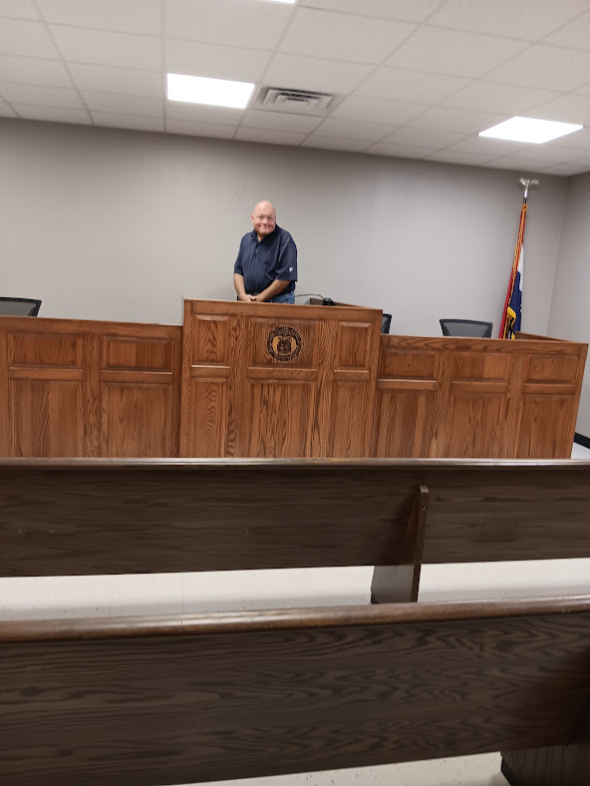
Mayor Glen Smith showing Matilda our City Court Room and explaining what types of meetings are held inside

Slide 12
After seeing Crocker City Hall, it was time to return to Church to eat lunch. The meal was delicious, and Matilda’s favorite food was Heath Toffee Chip Cookies. We purchased a bag of the Toffee Chips for both her and Linda Holt. The recipe for the cookies was on the back of the bag and this enabled them to enjoy these sweet treats when they returned home!

Slide 13
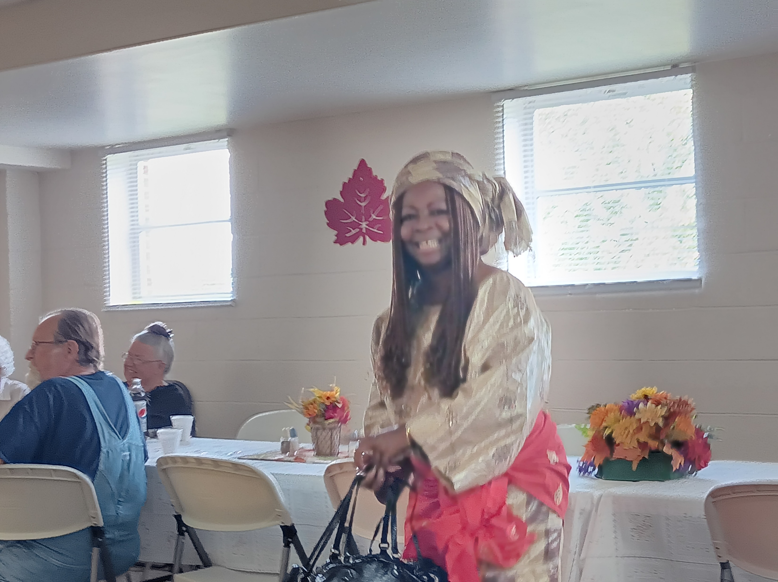
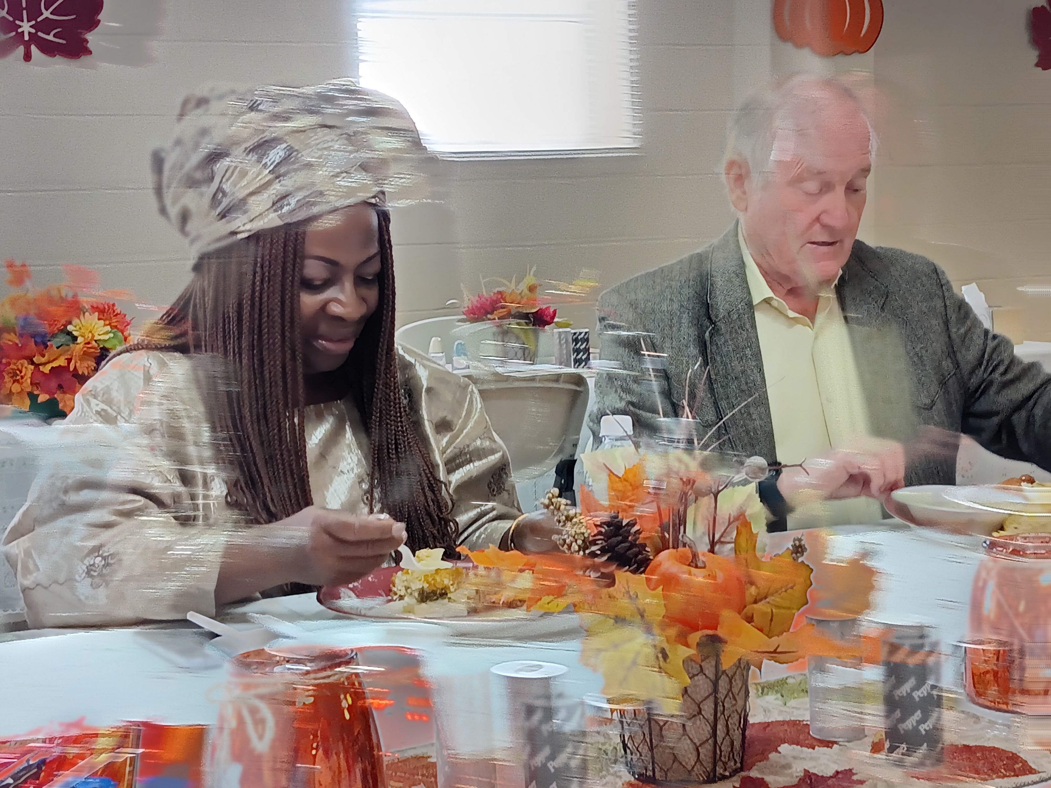
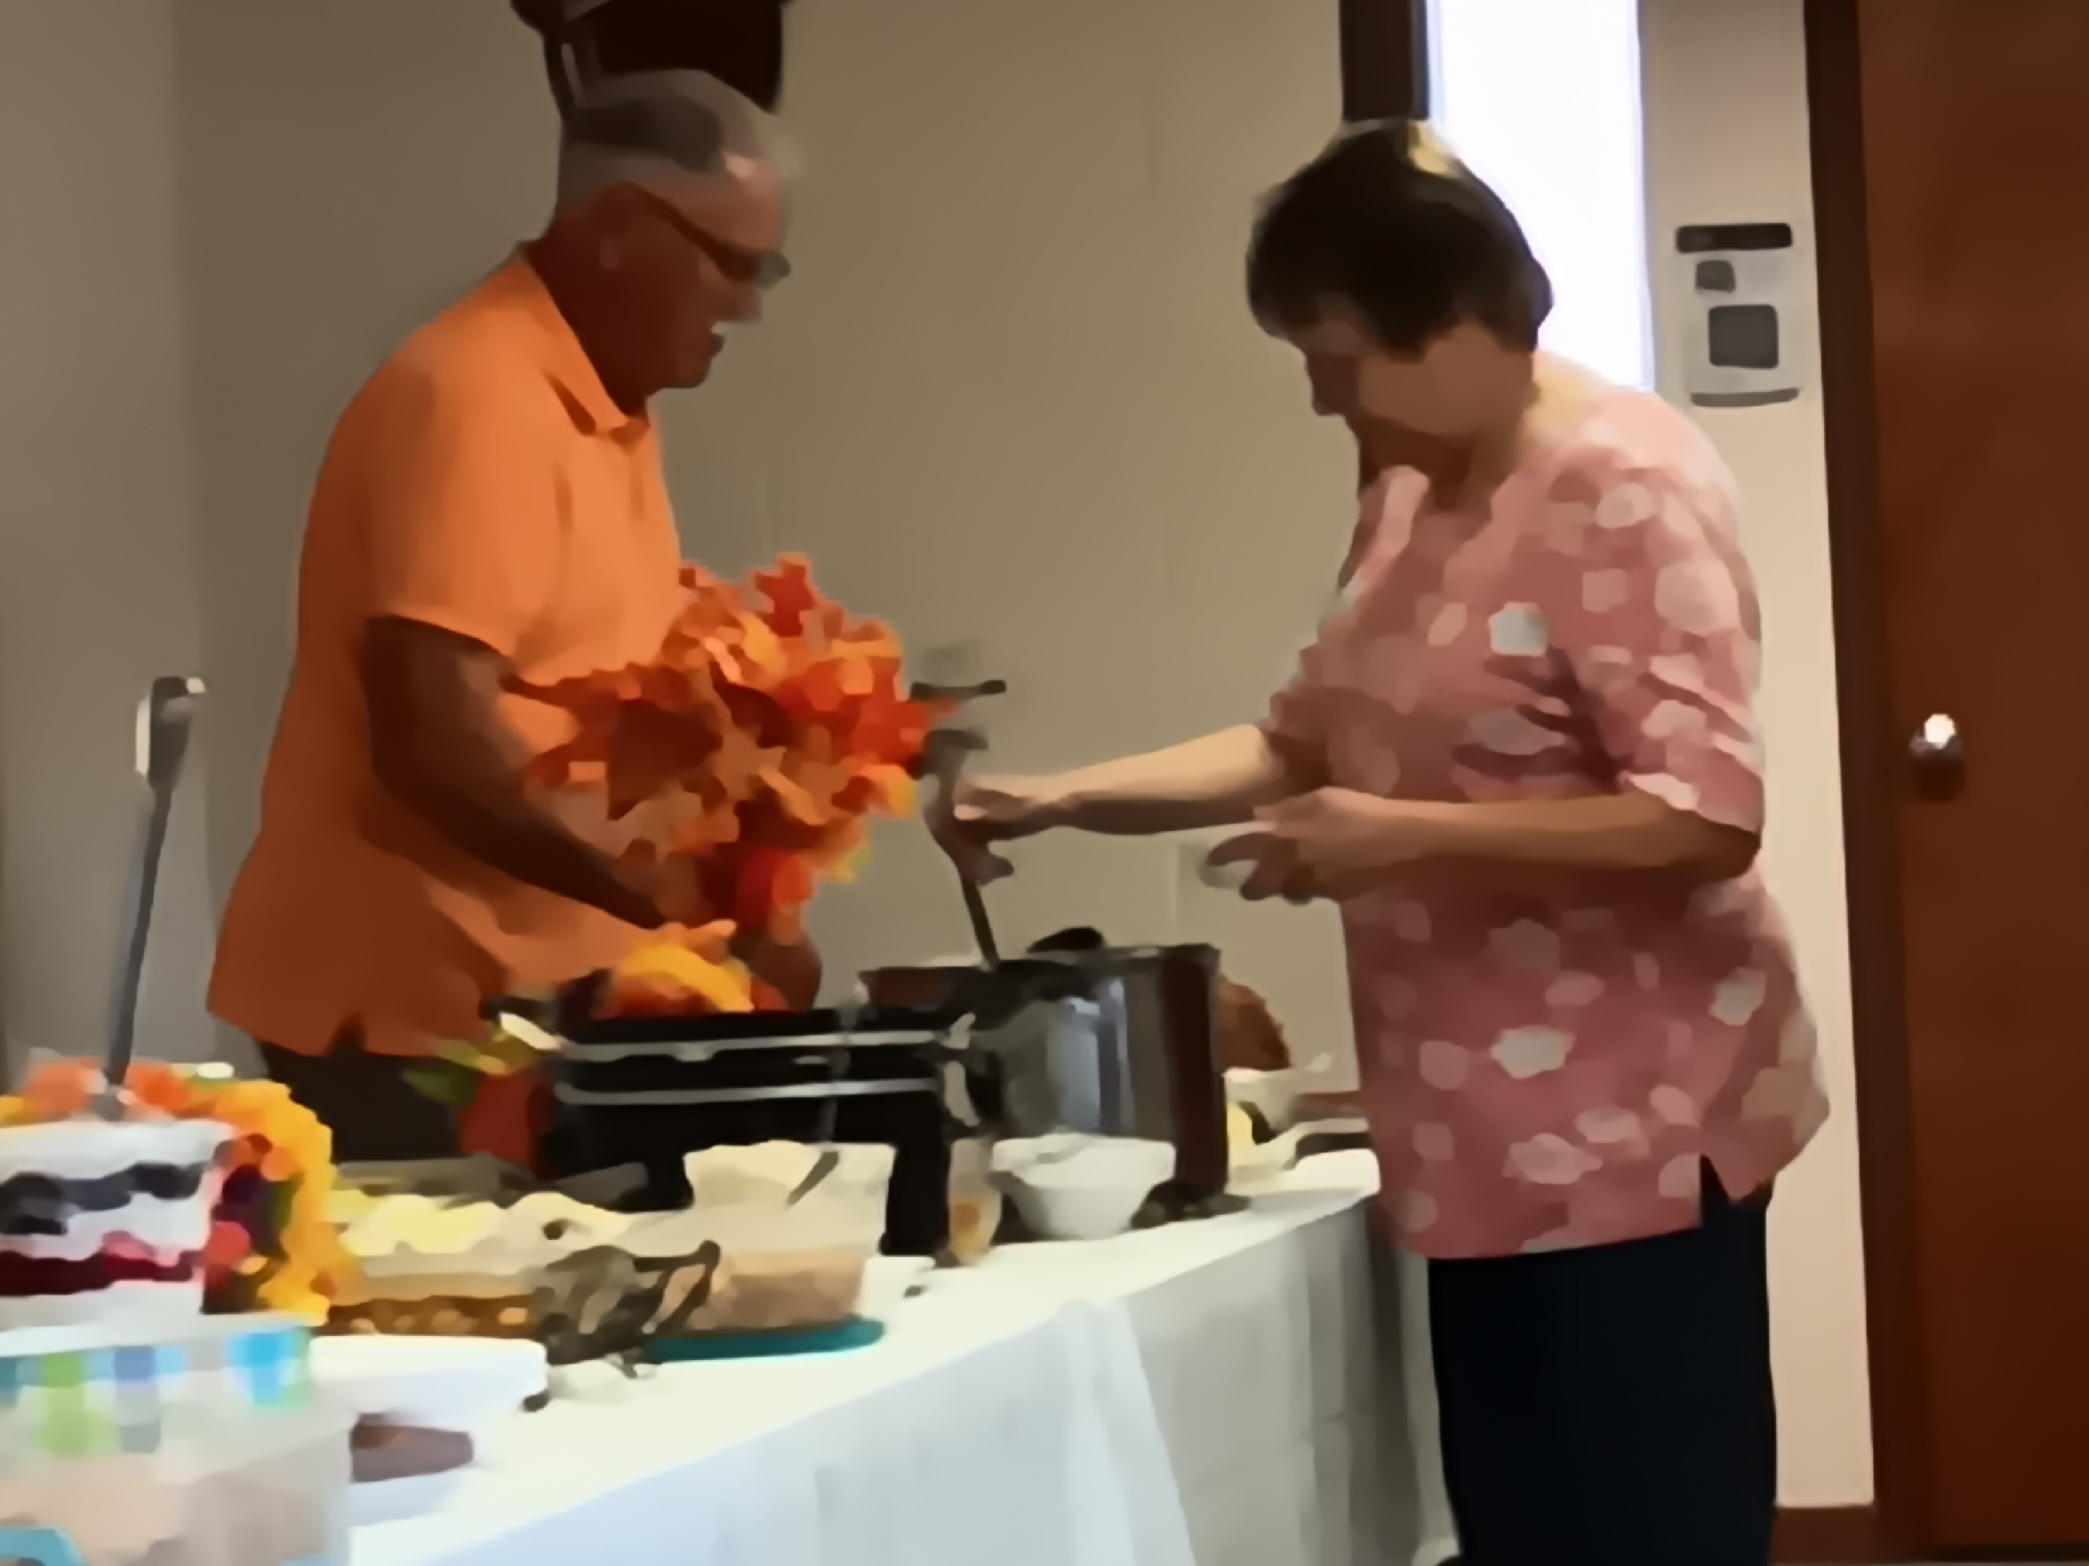
Matilda smiling at all of the good food and decorations and the individuals she had met.
Matilda Parker and Pastor Bill Agnew enjoying lunch together.
Clerk of the Session-Ronnie Layman and Janet Marso working their way down the food table.

Slide 14
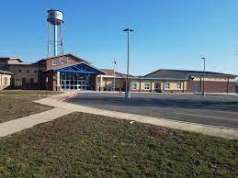
Last stop on the tour is the Crocker High School & Elementary School.

Slide 15
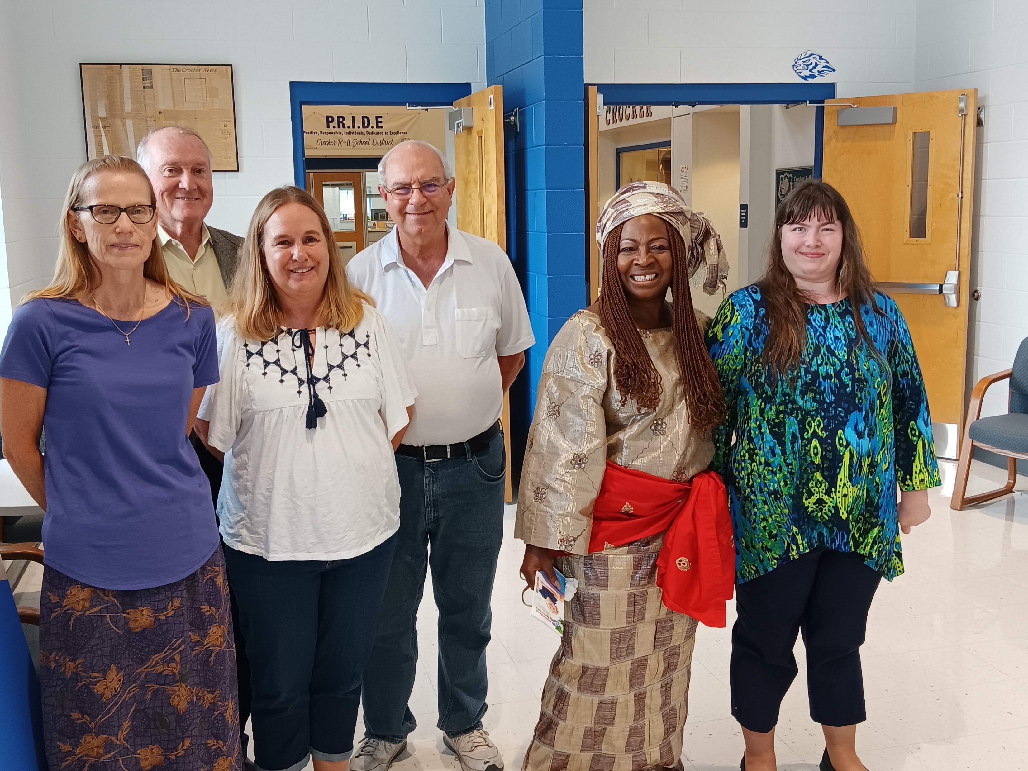
Left to Right-Church Song Leader & School Librarian Jackie Scholfield, Pastor Bill Agnew,Linda & Jim Holt, Matilda Parker and Katelyn Fraski. Photographer Ian Fraski and Elder Debbie Fraski not pictured.

Slide 16
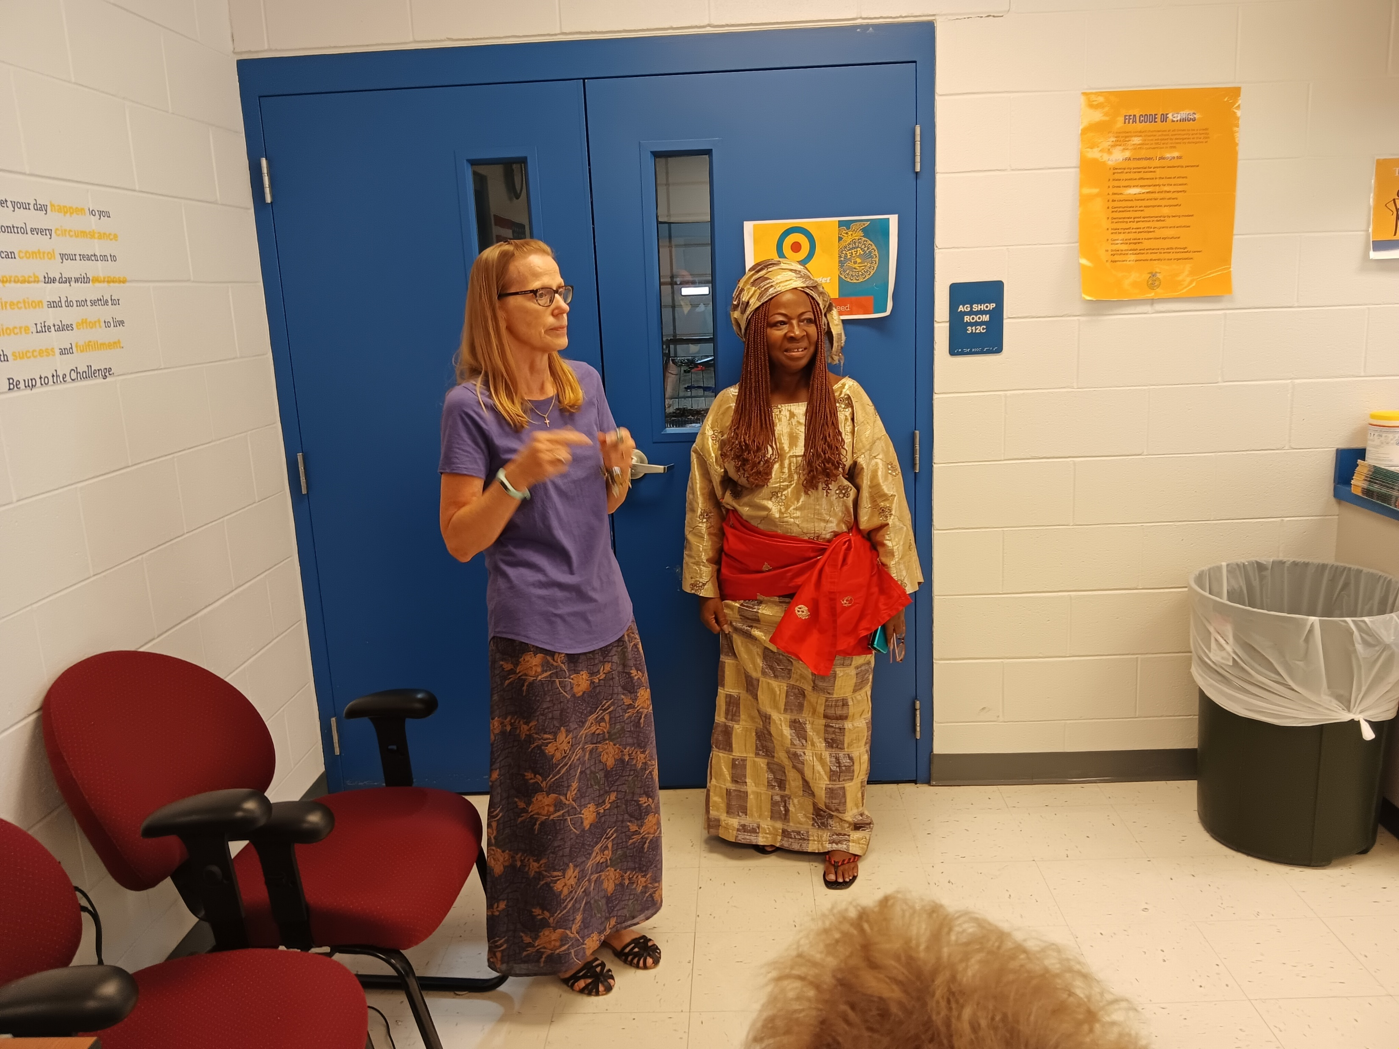
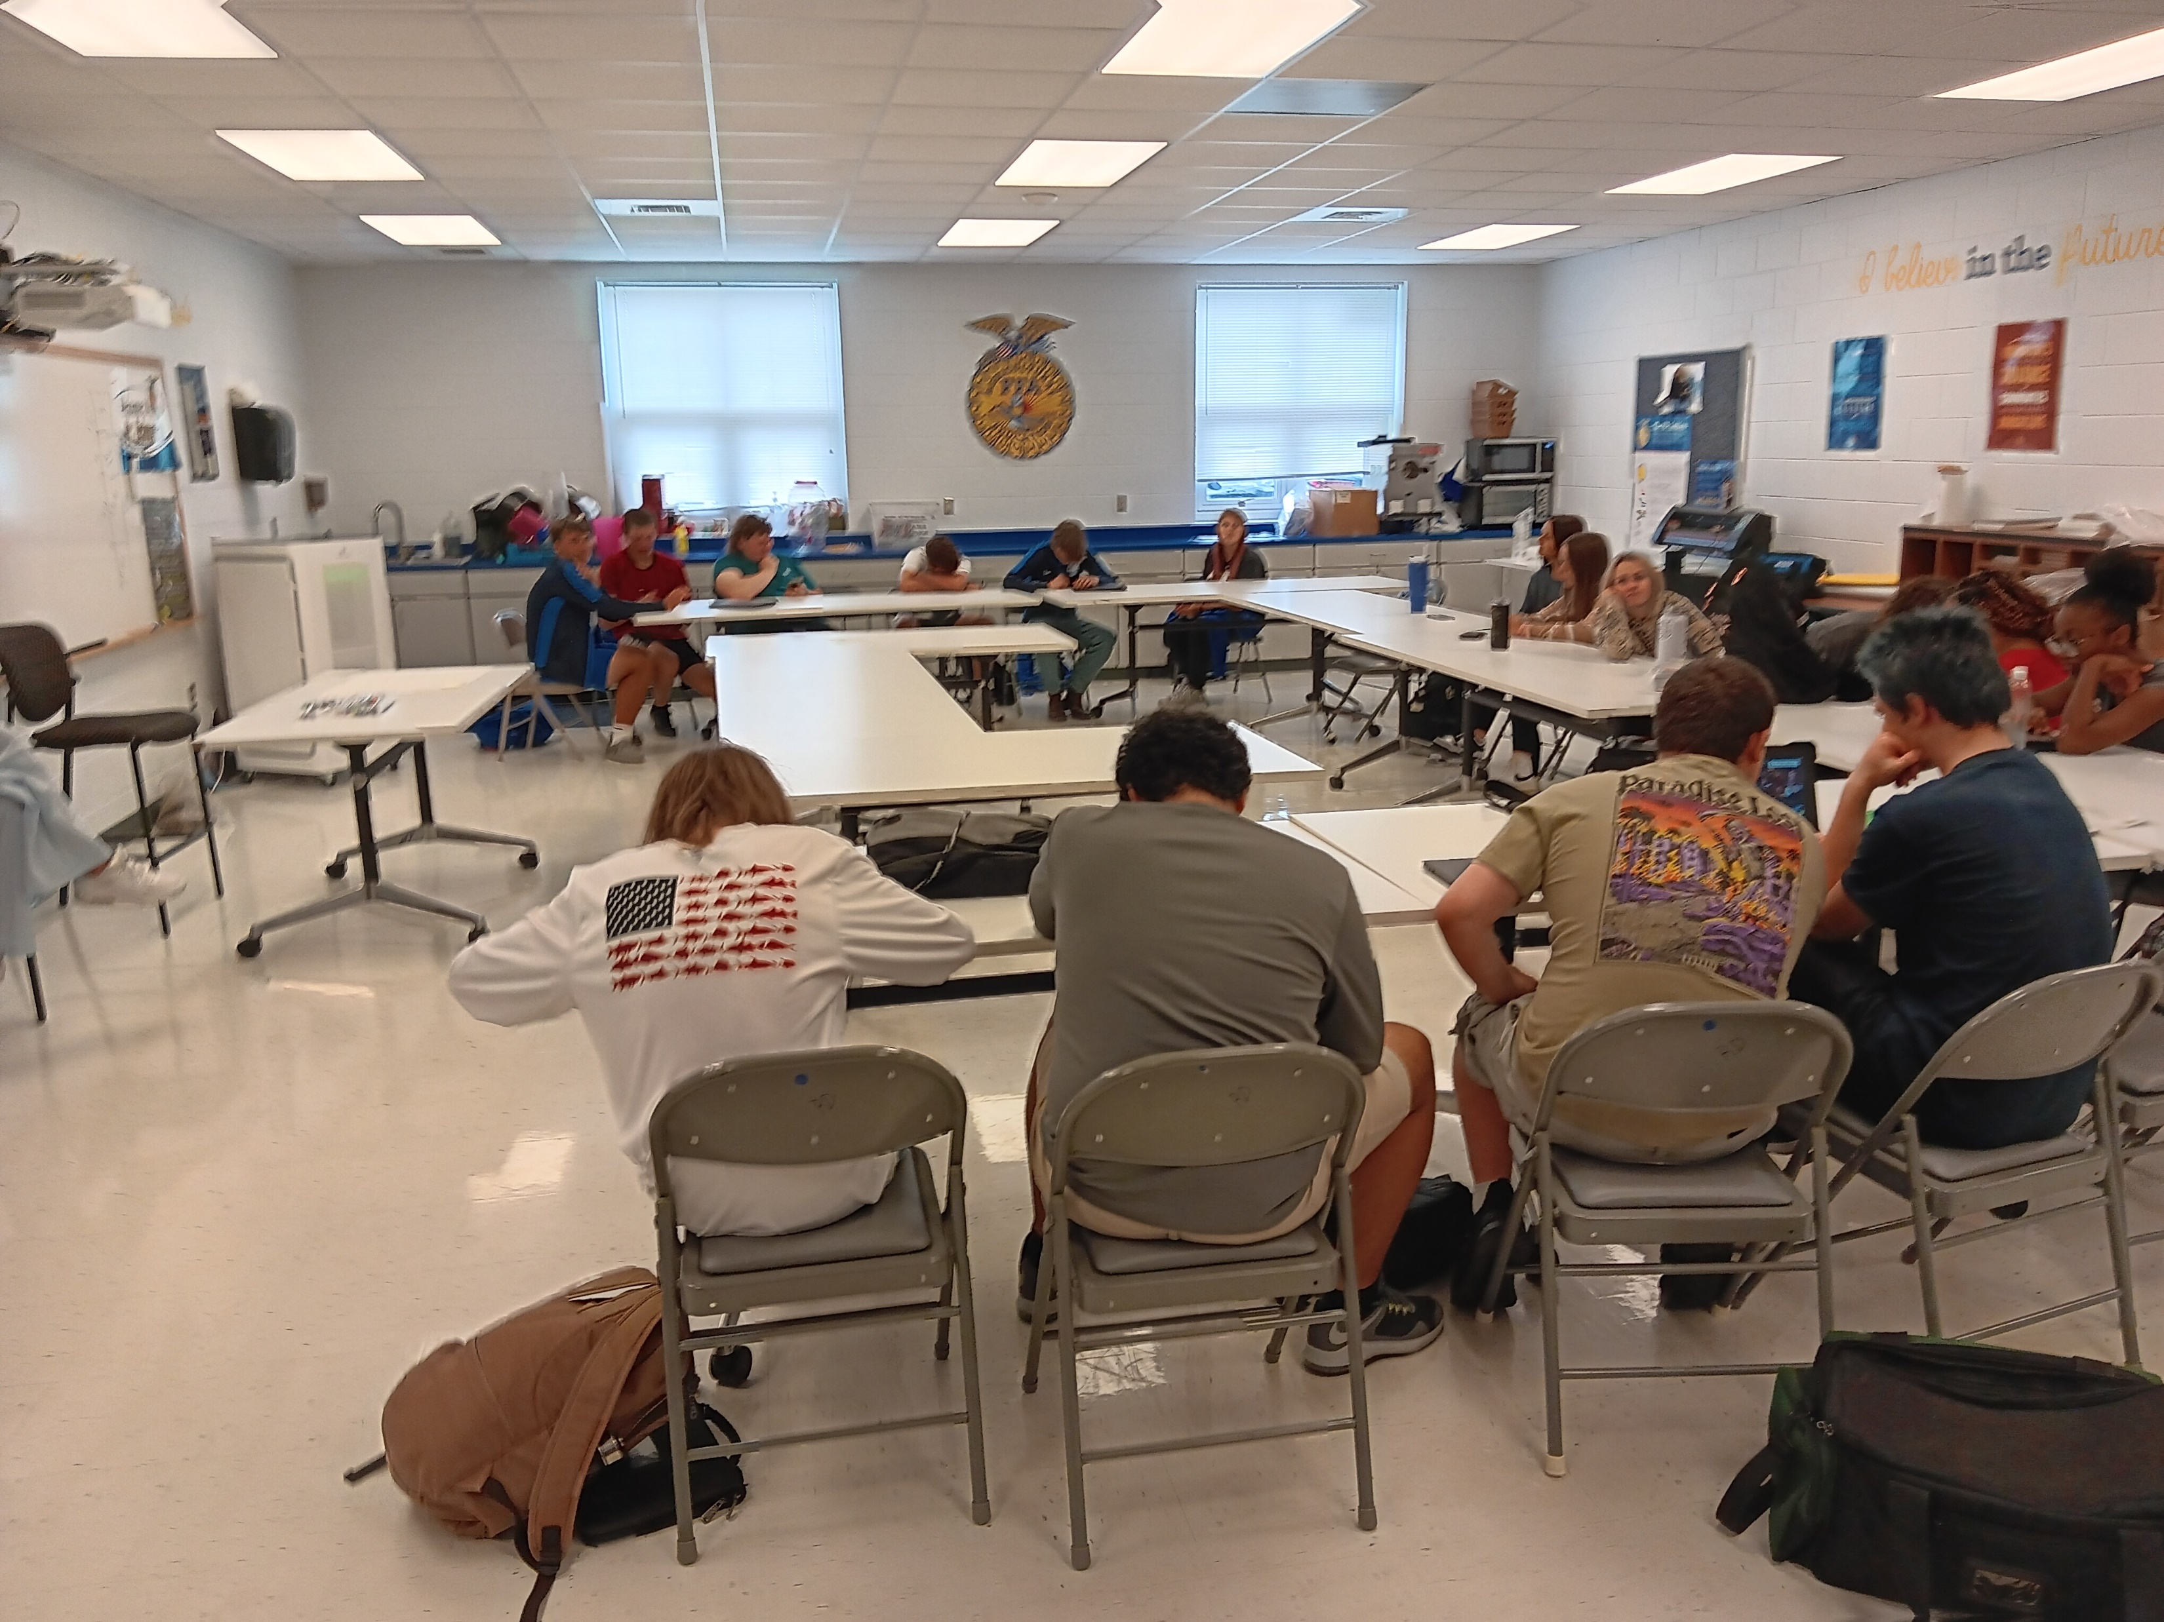
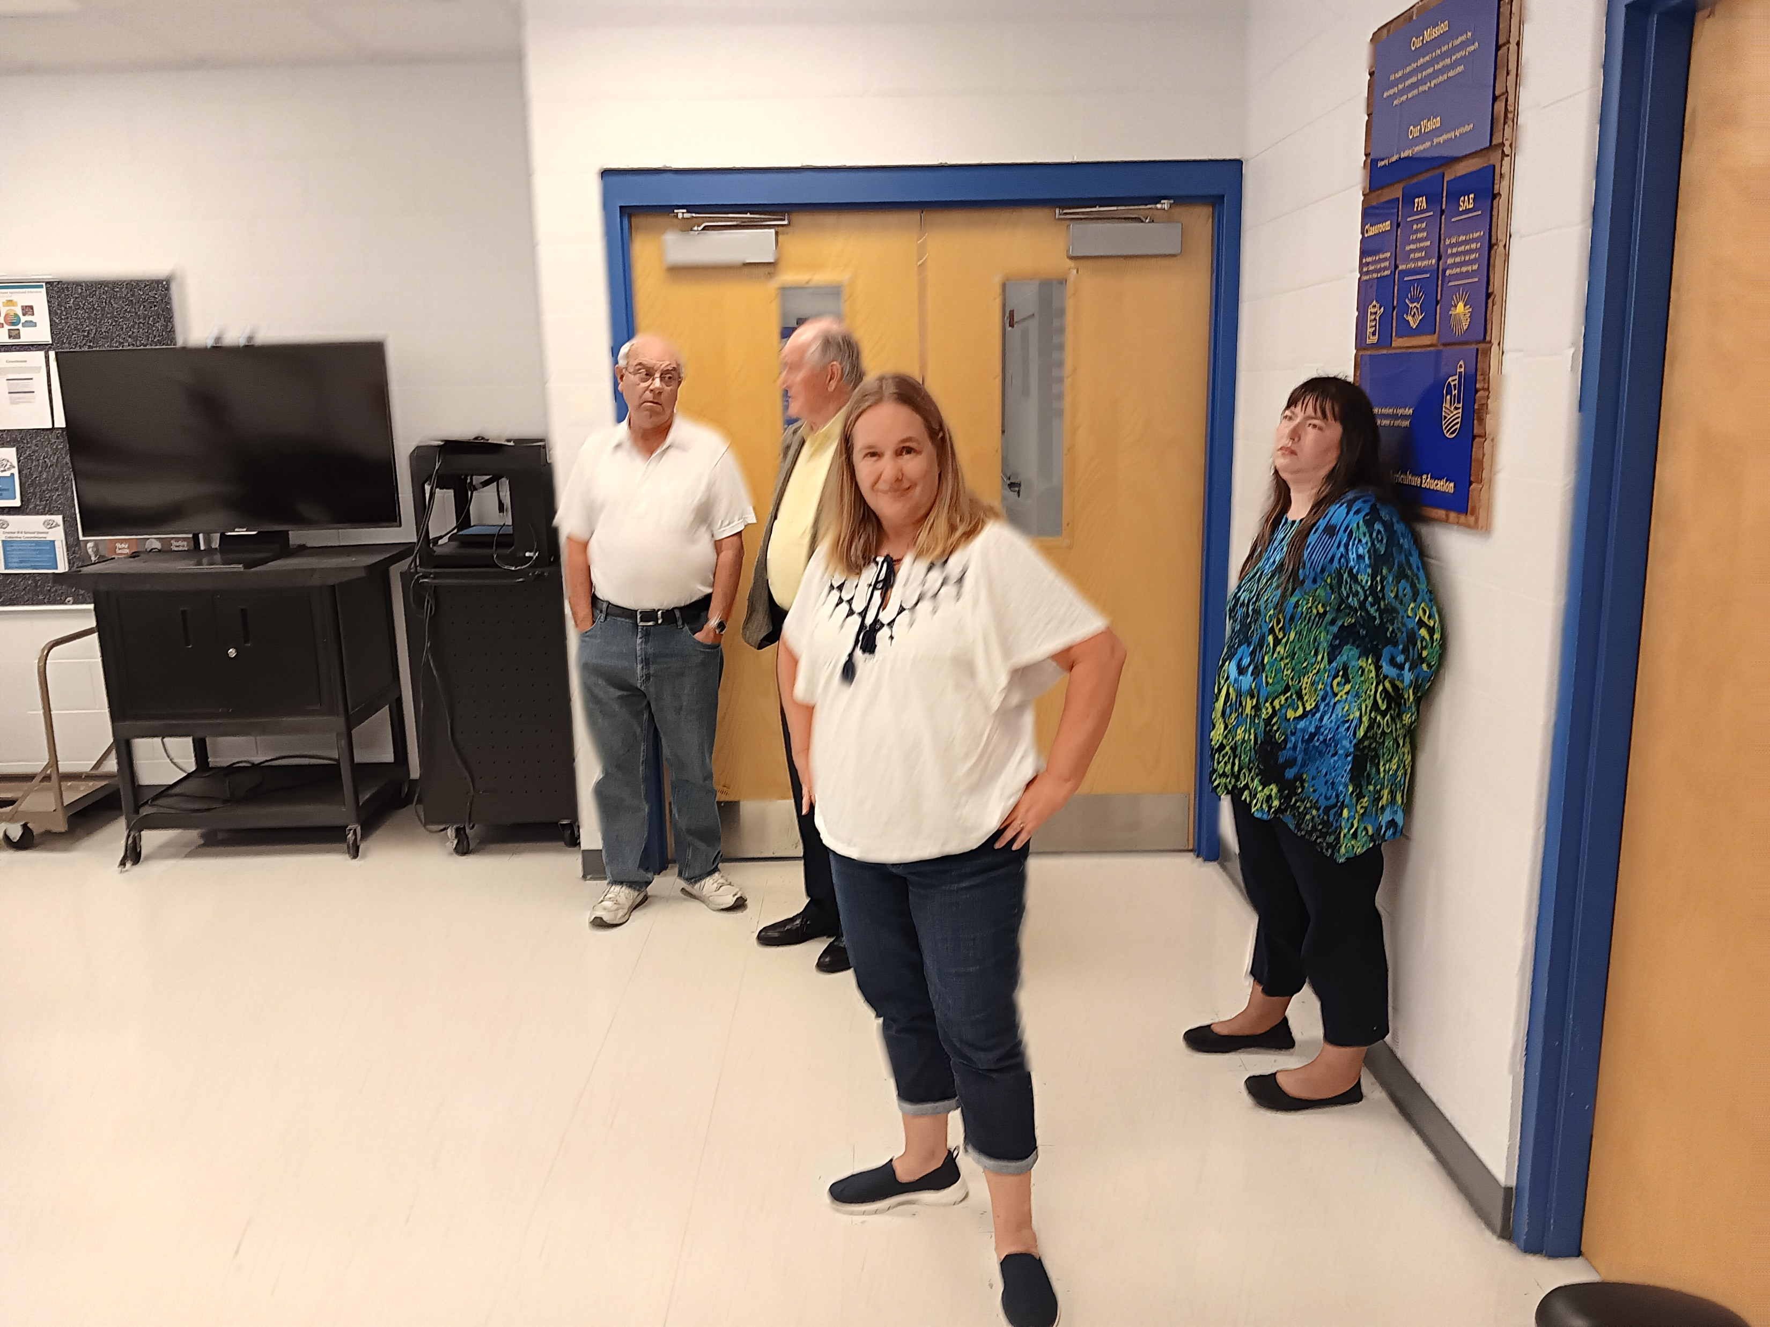
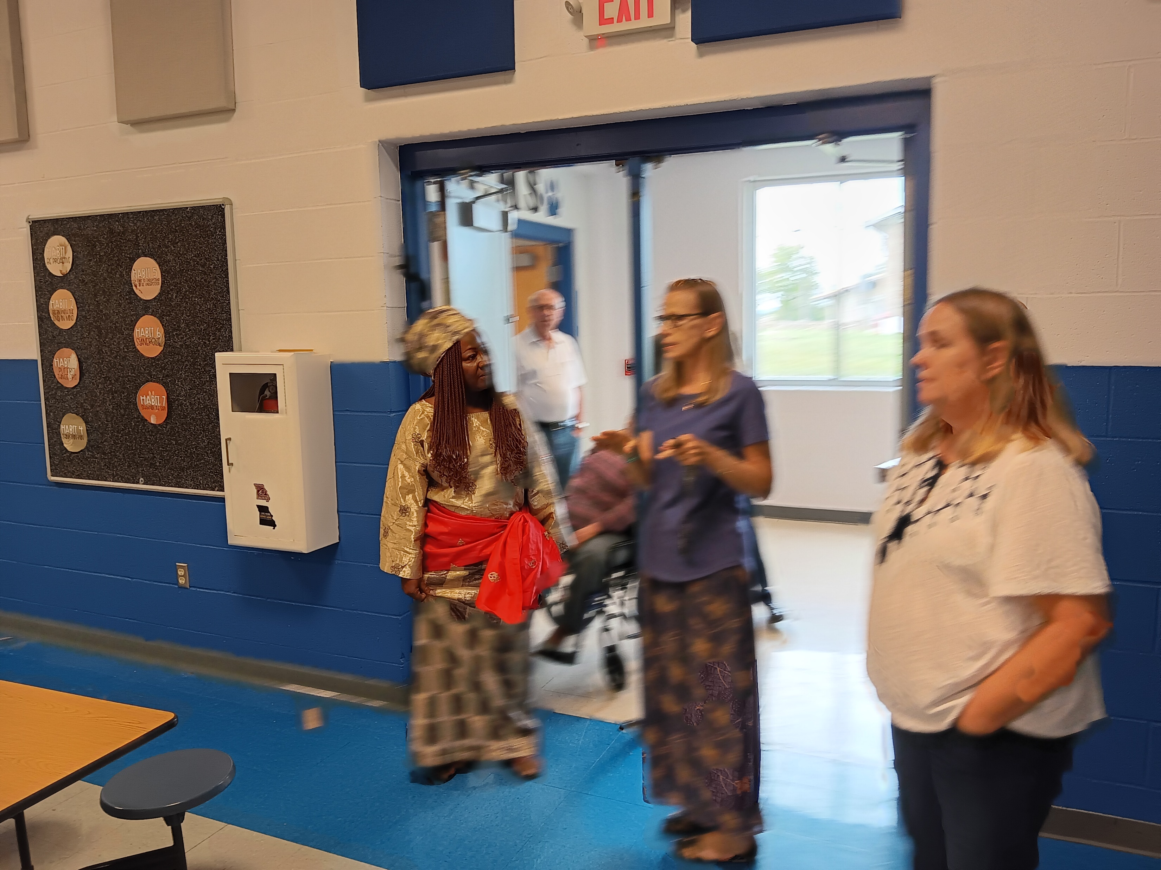

Slide 17
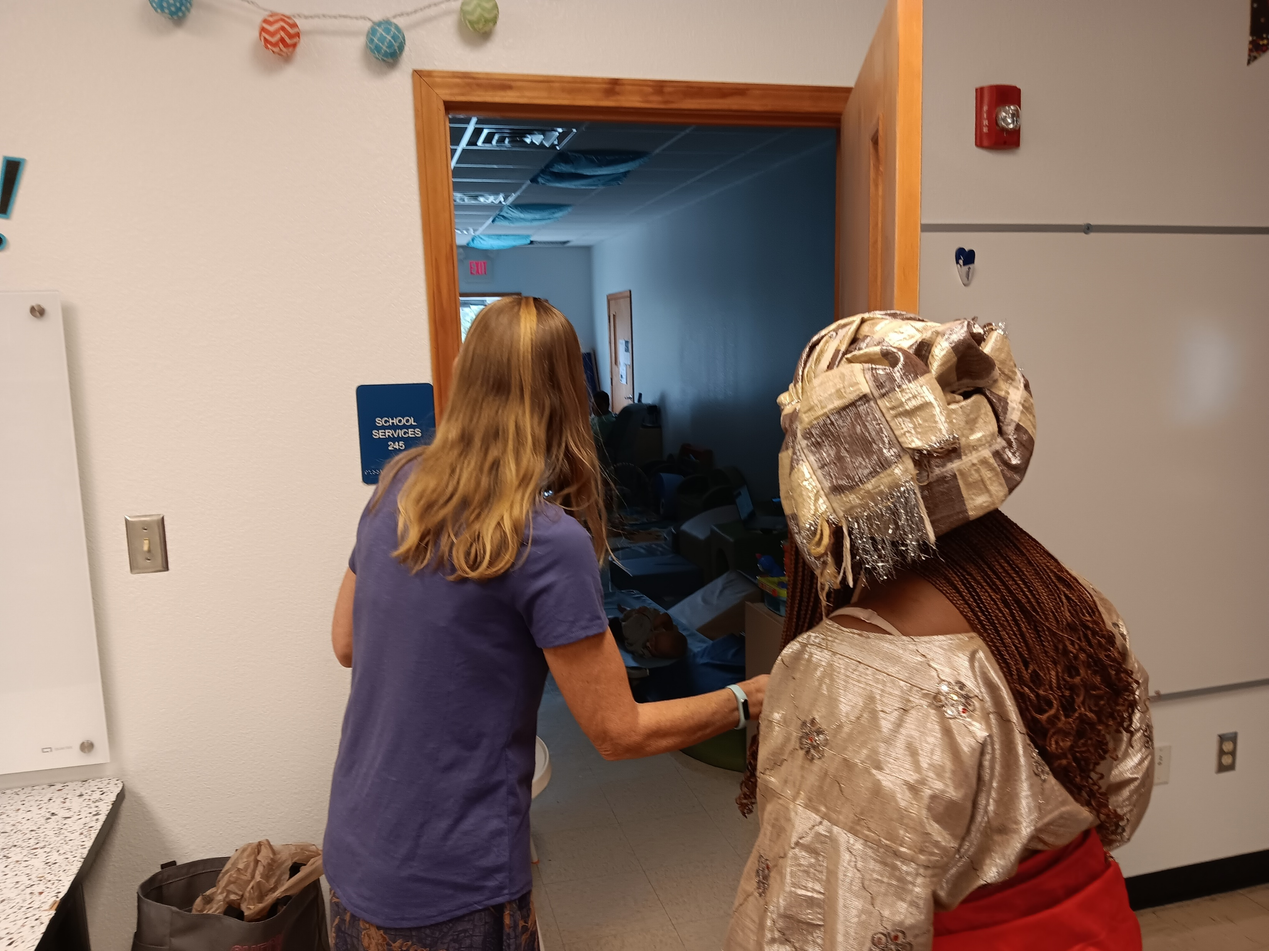
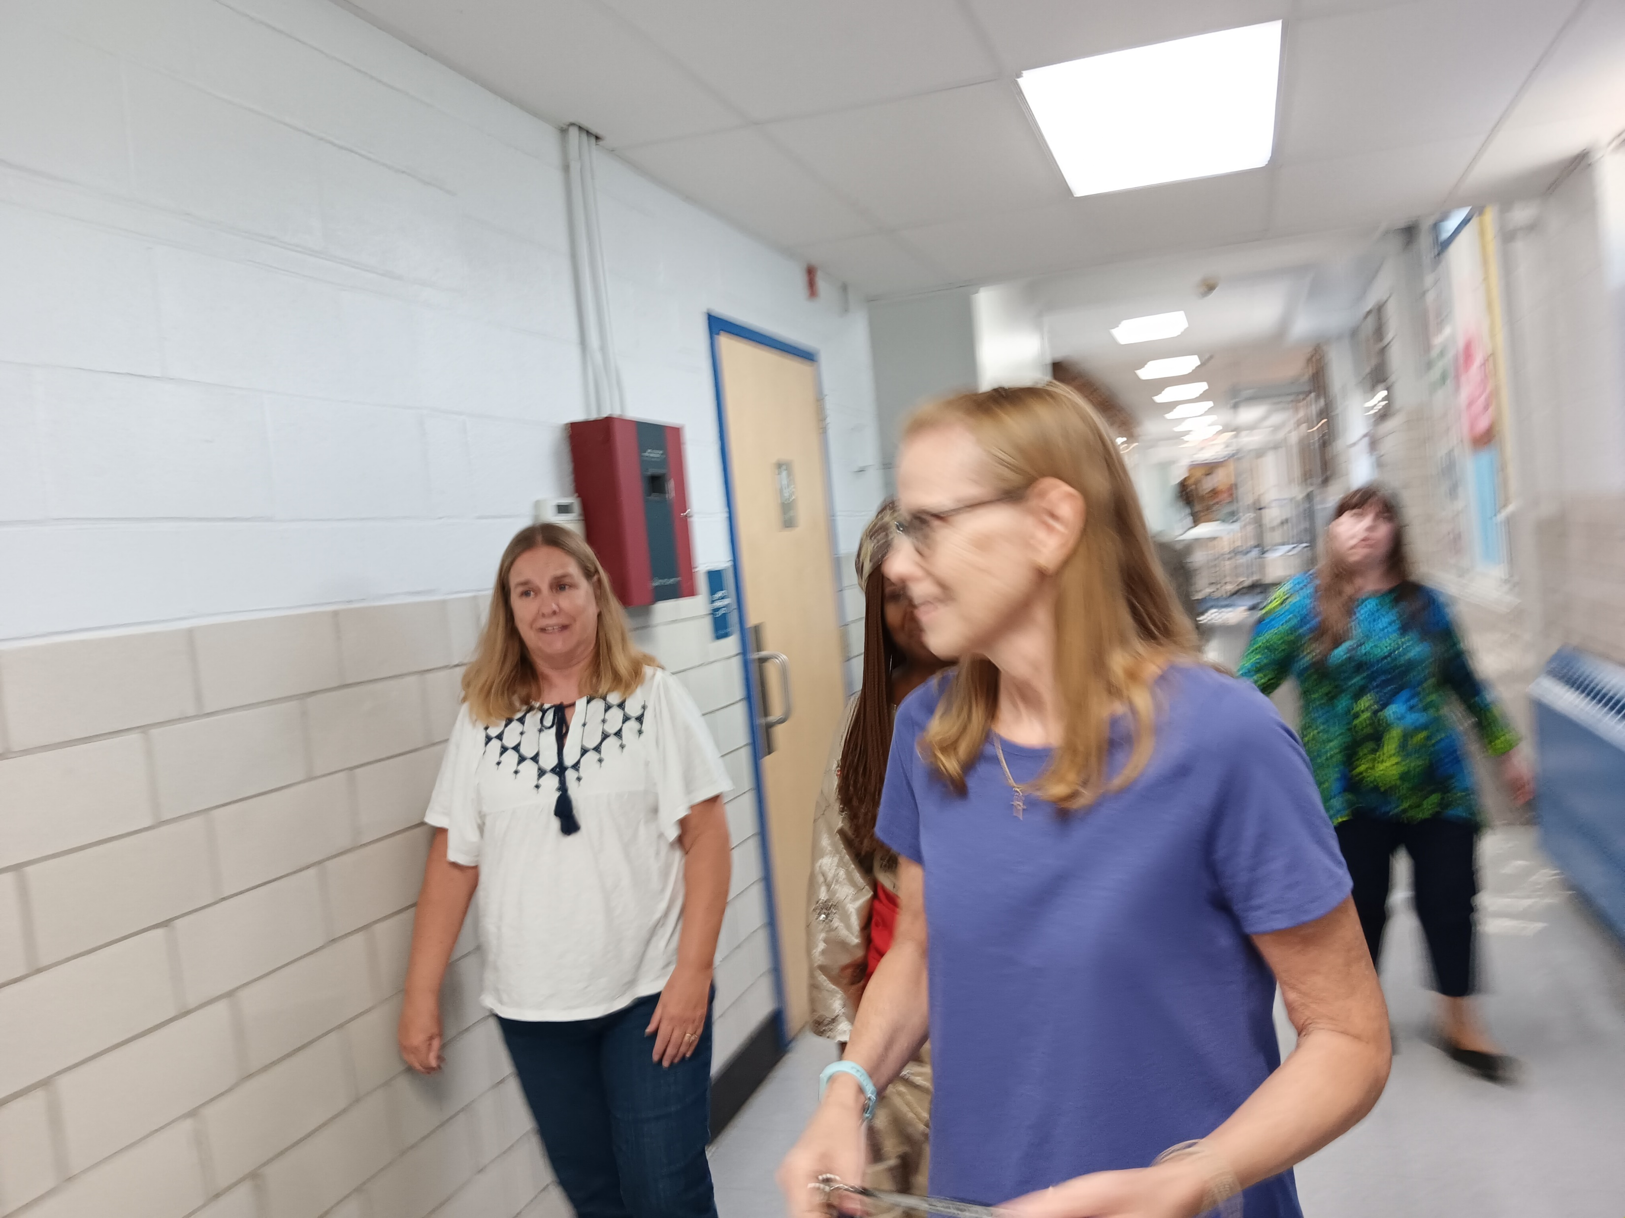
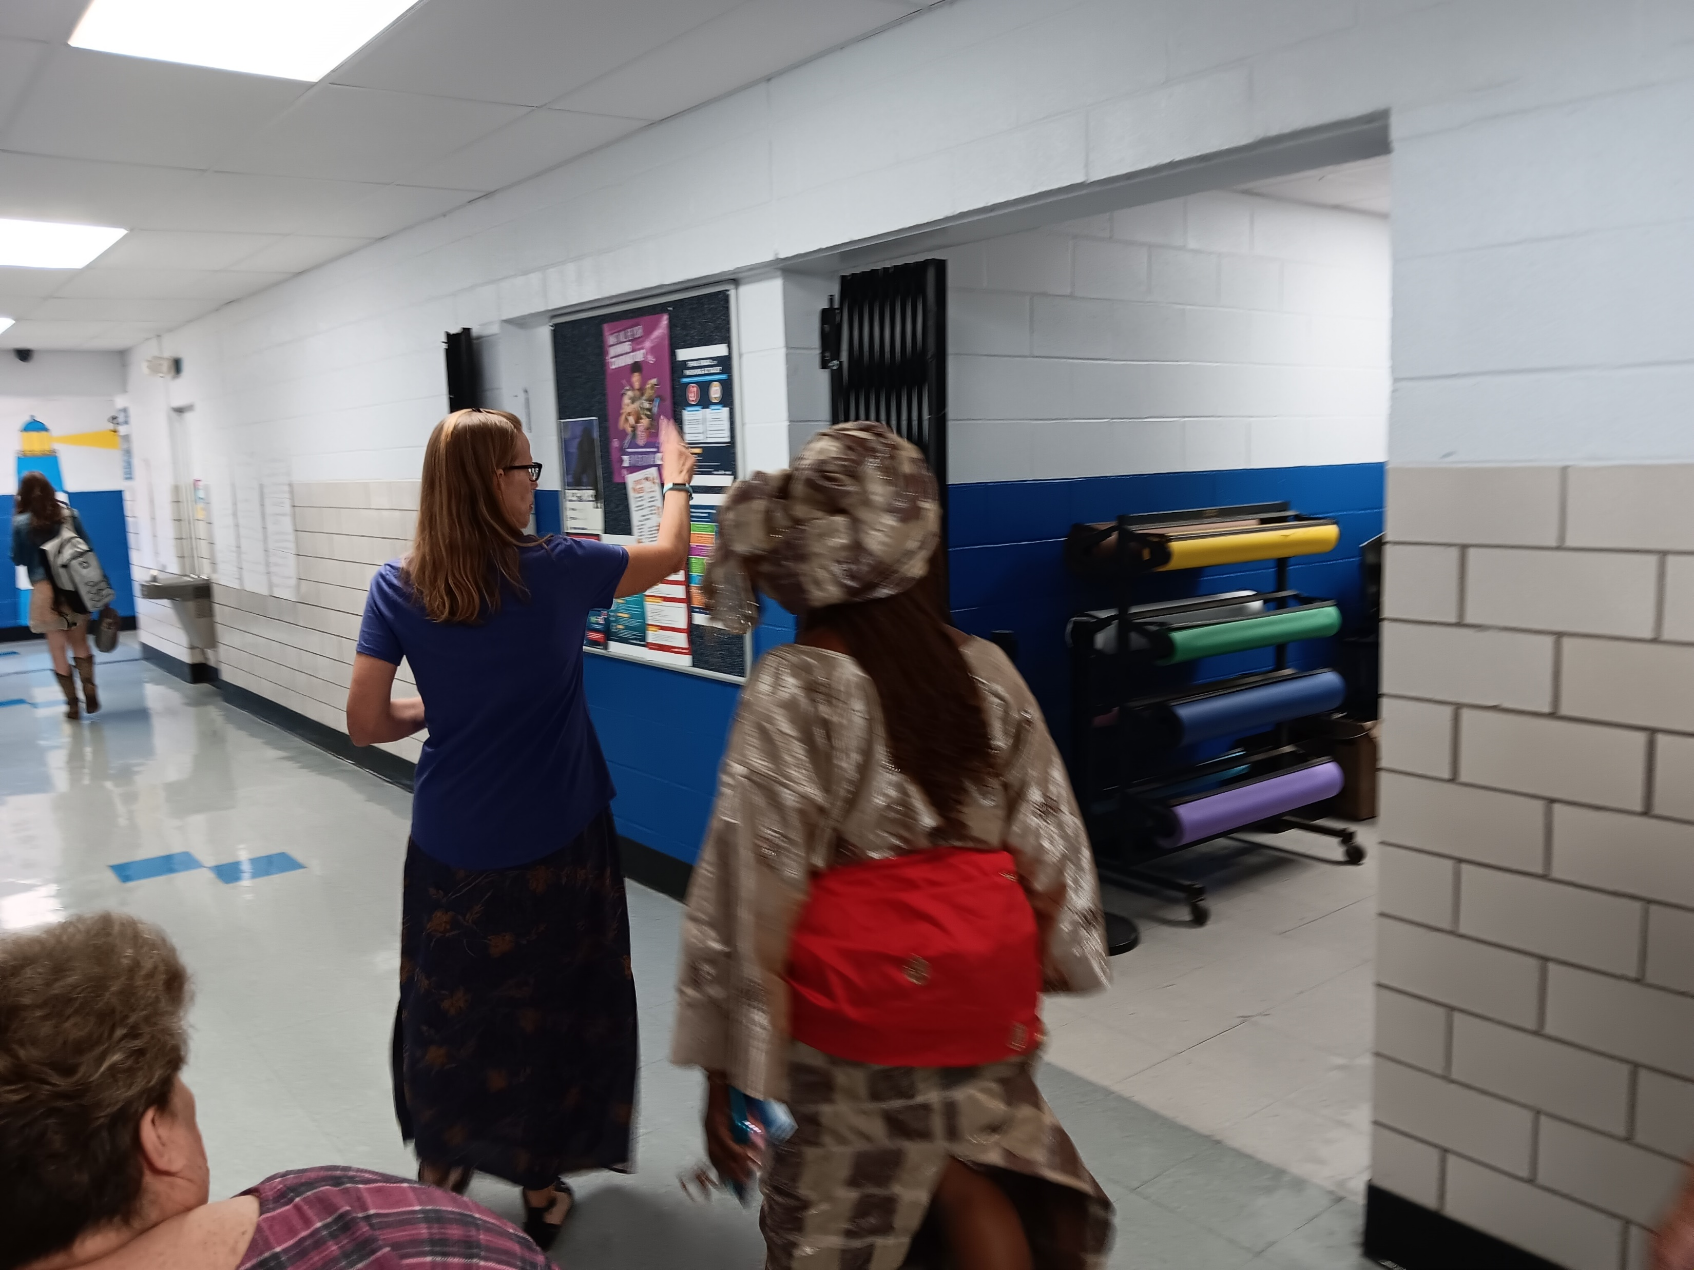
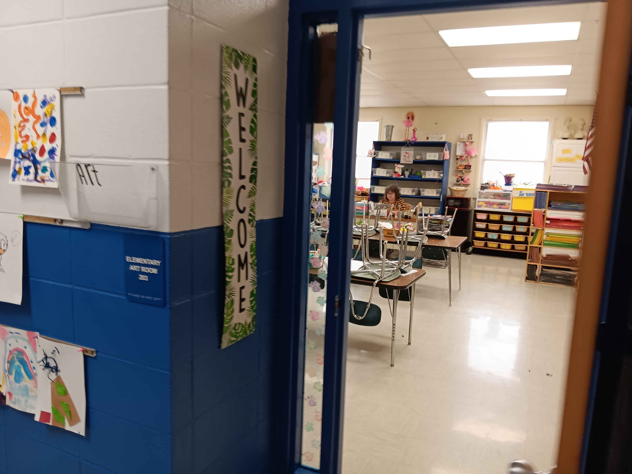
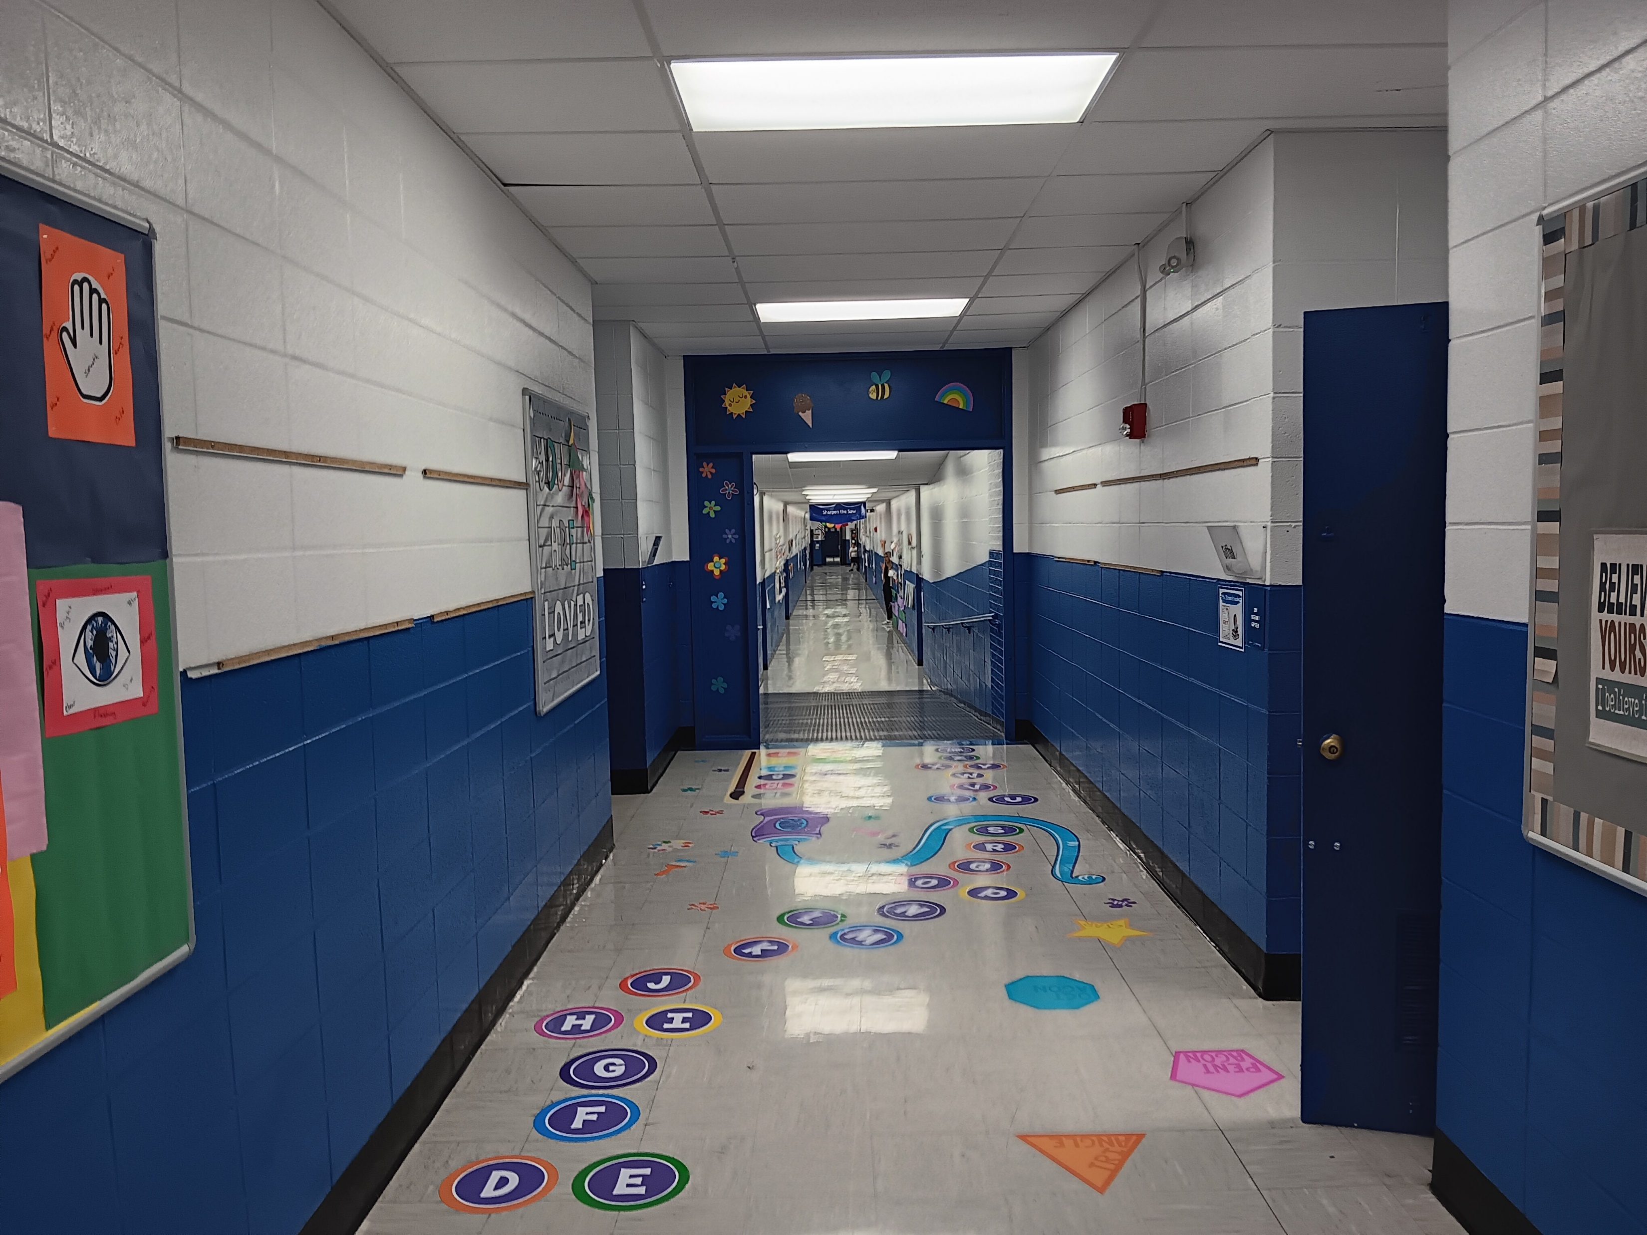
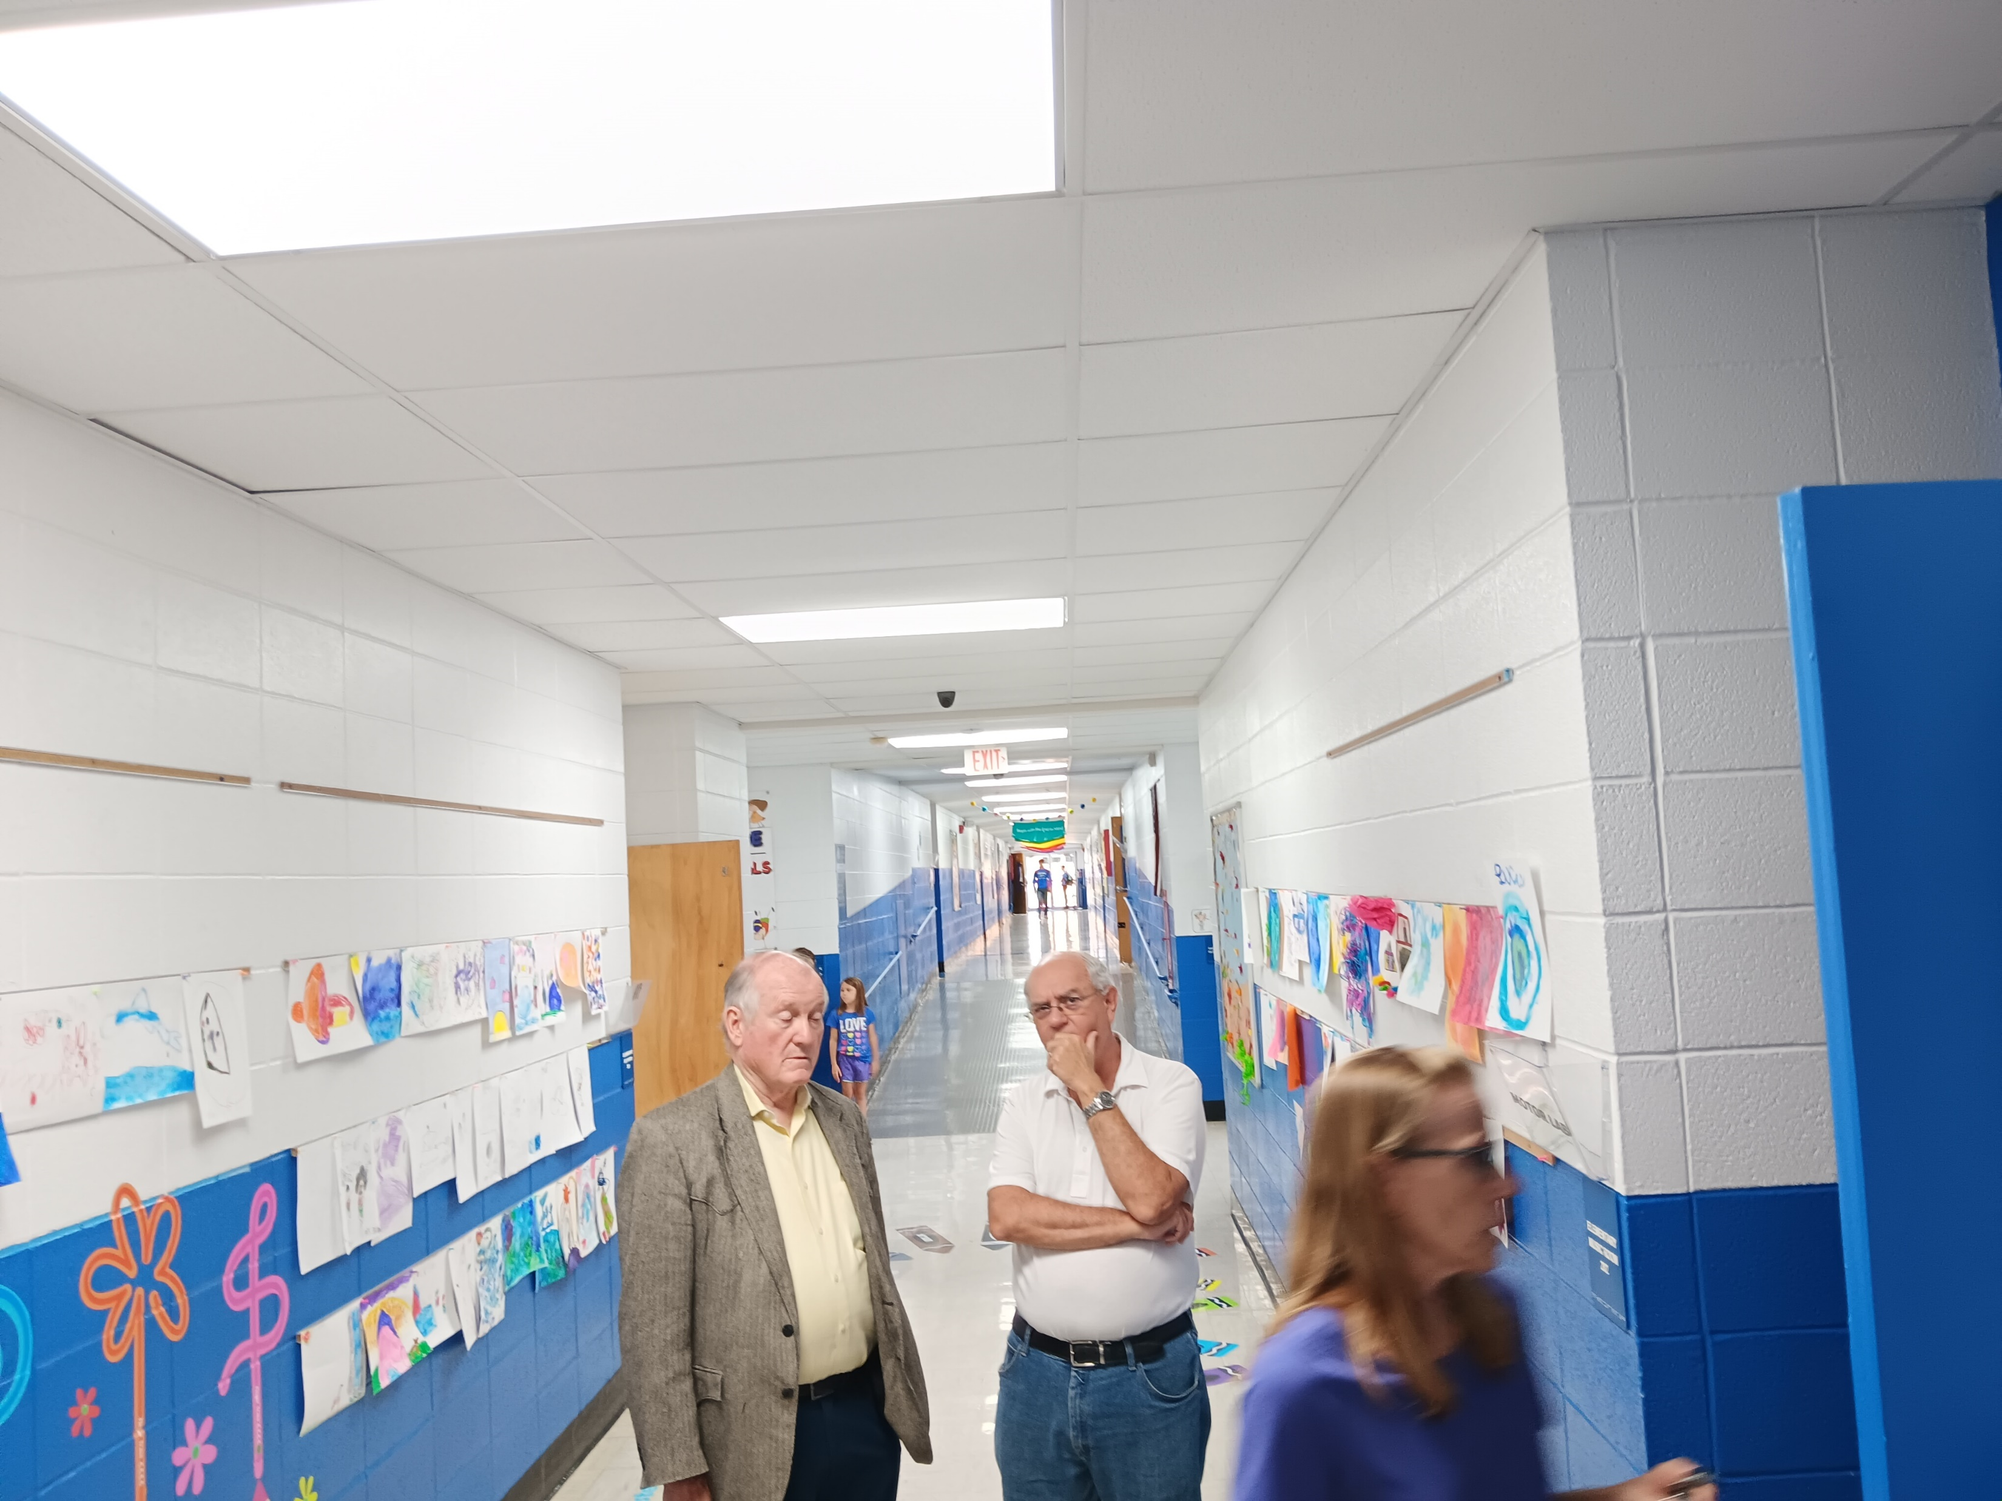

Slide 18
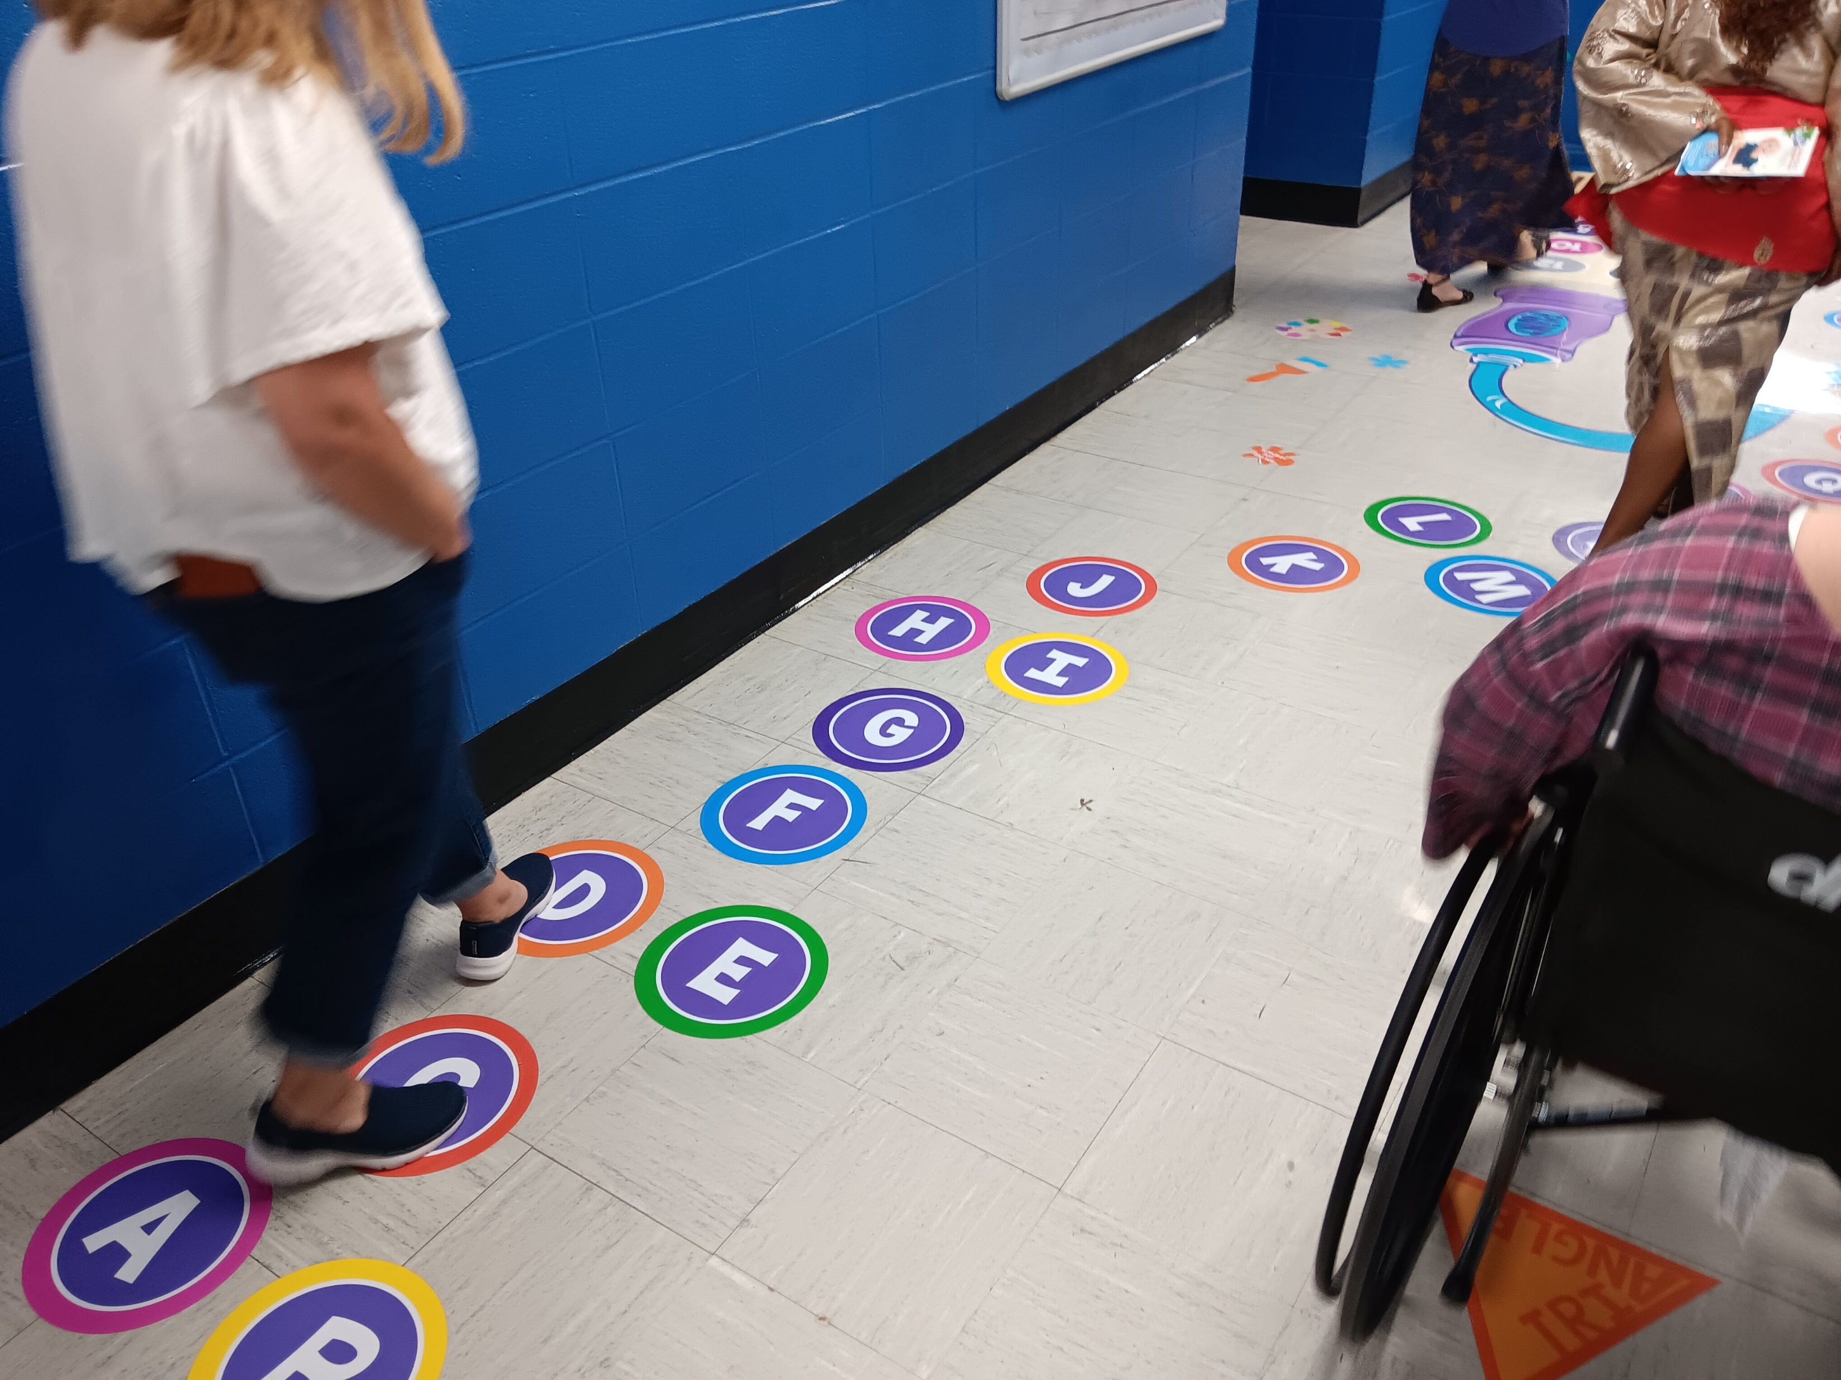
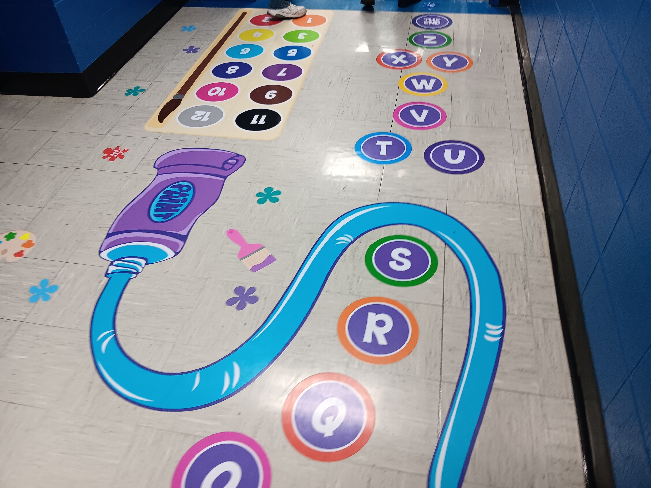
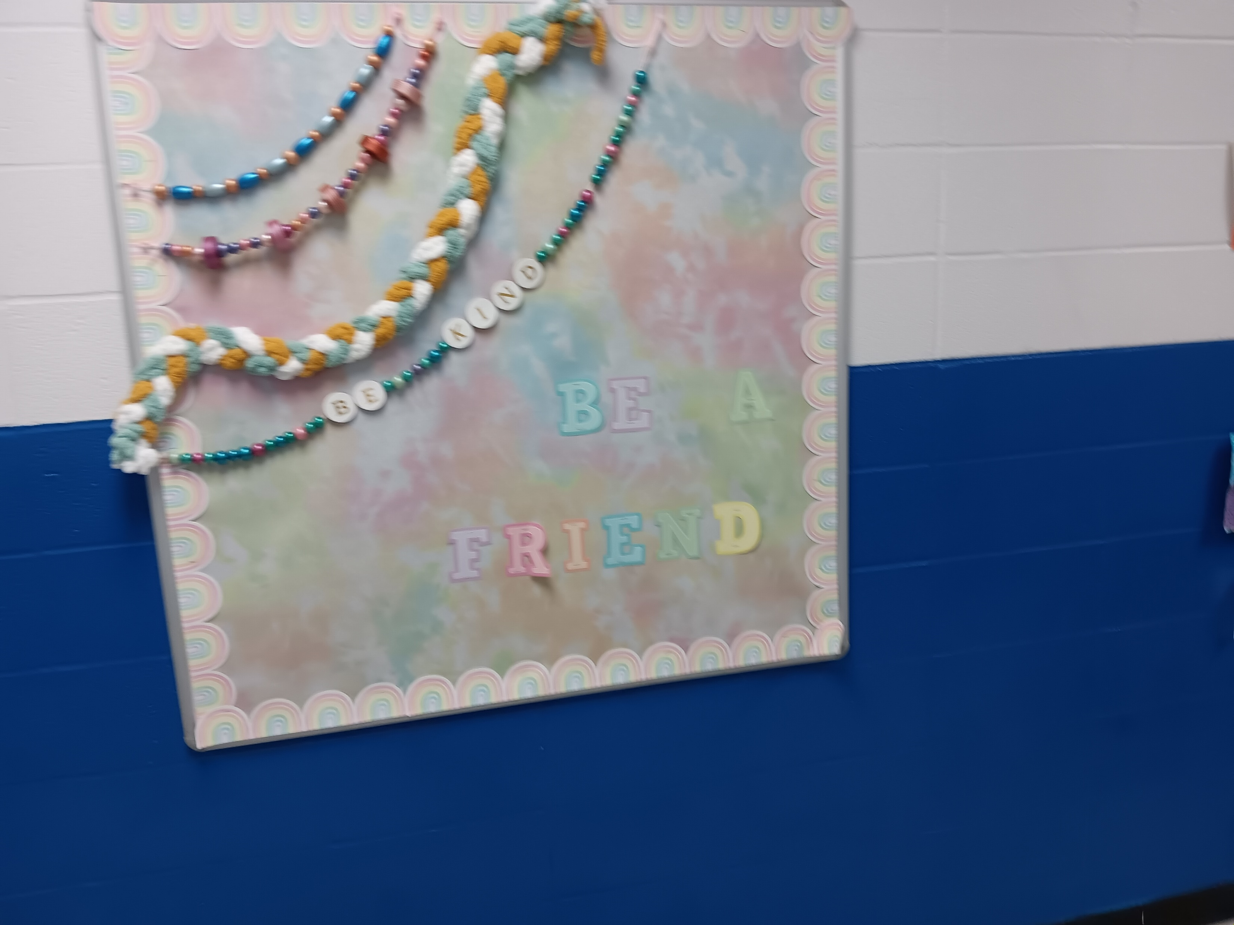
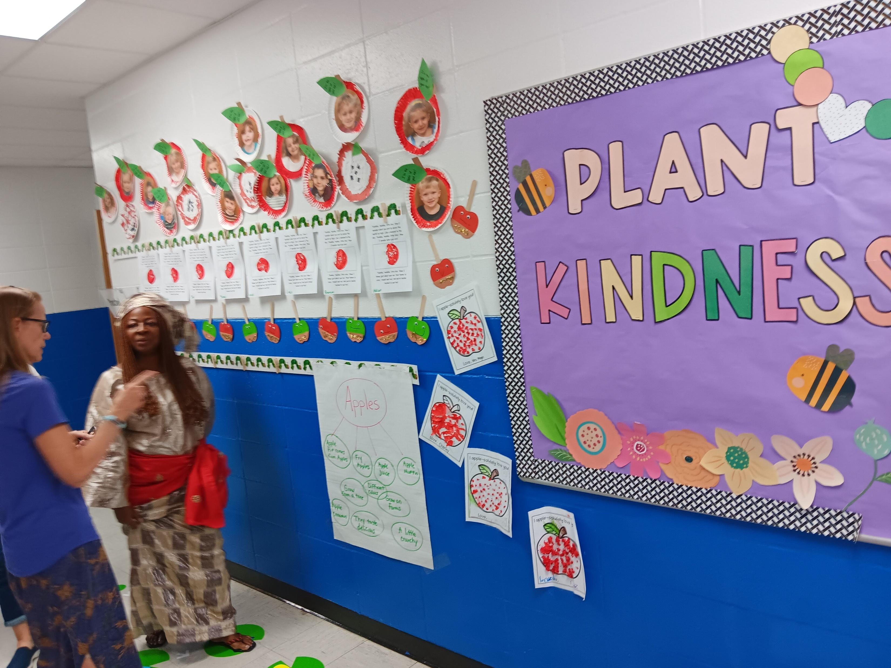
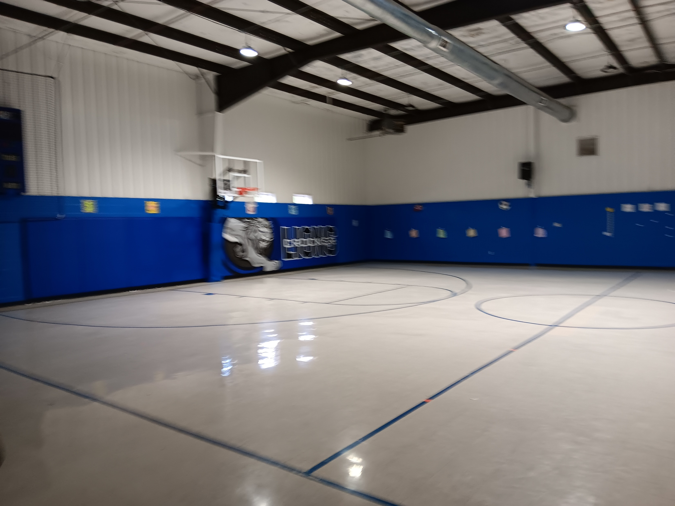
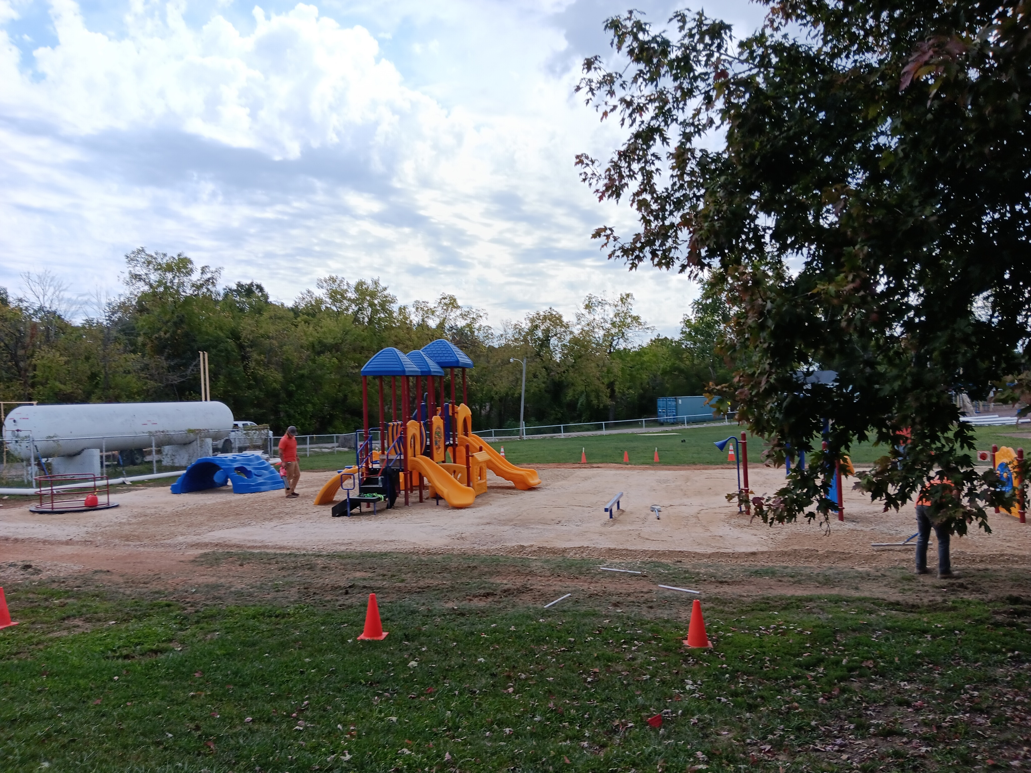

Slide 19
Matilda Wokie Parker gave a very informative presentation covering the establishment of the country of Liberia, which I might add is modeled after our U.S. Democratic Three Branch System of Government. In addition, she showed images of their beautiful countryside and explained the problem situations that her country was experiencing, as well as the contact information for her assistive foundation.

Slide 20
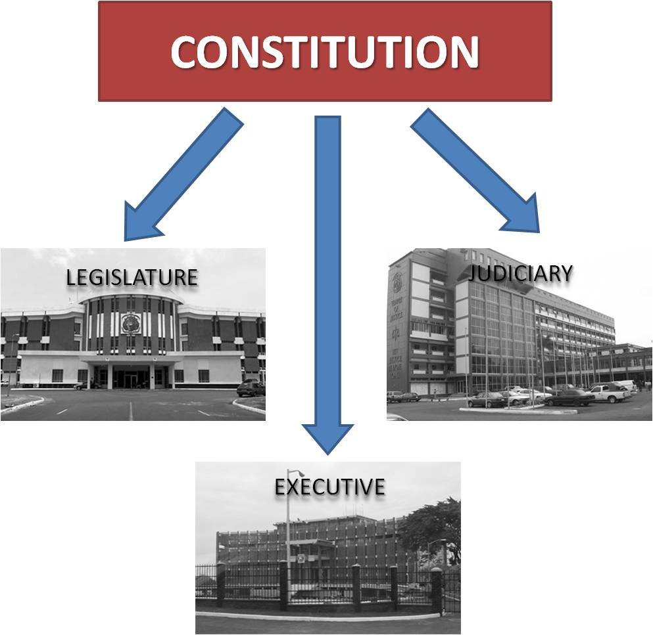
The single star portrays the only independent style government in West Africa. The eleven stripes represent the eleven men who signed the Declaration of Independence of Liberian.

Slide 21
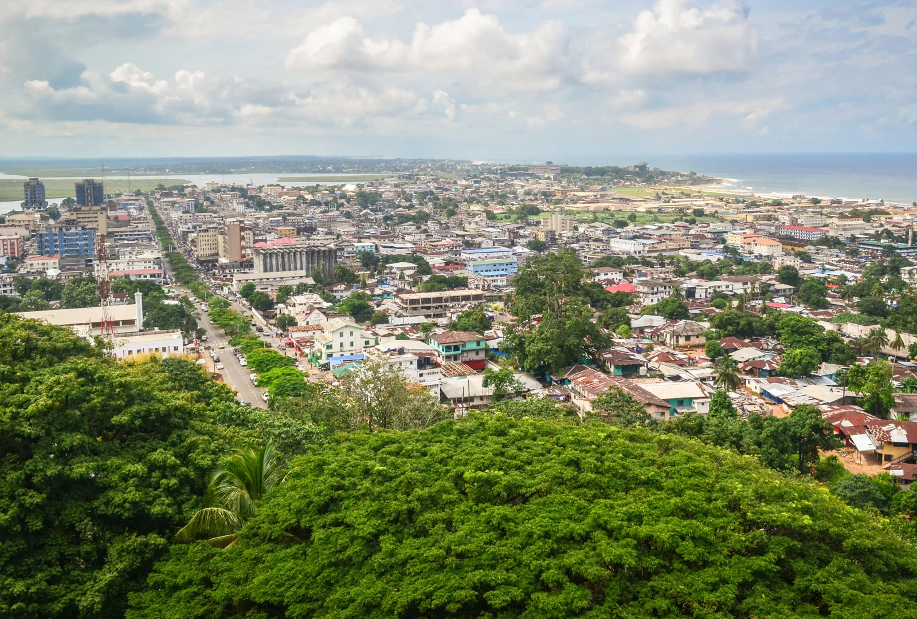
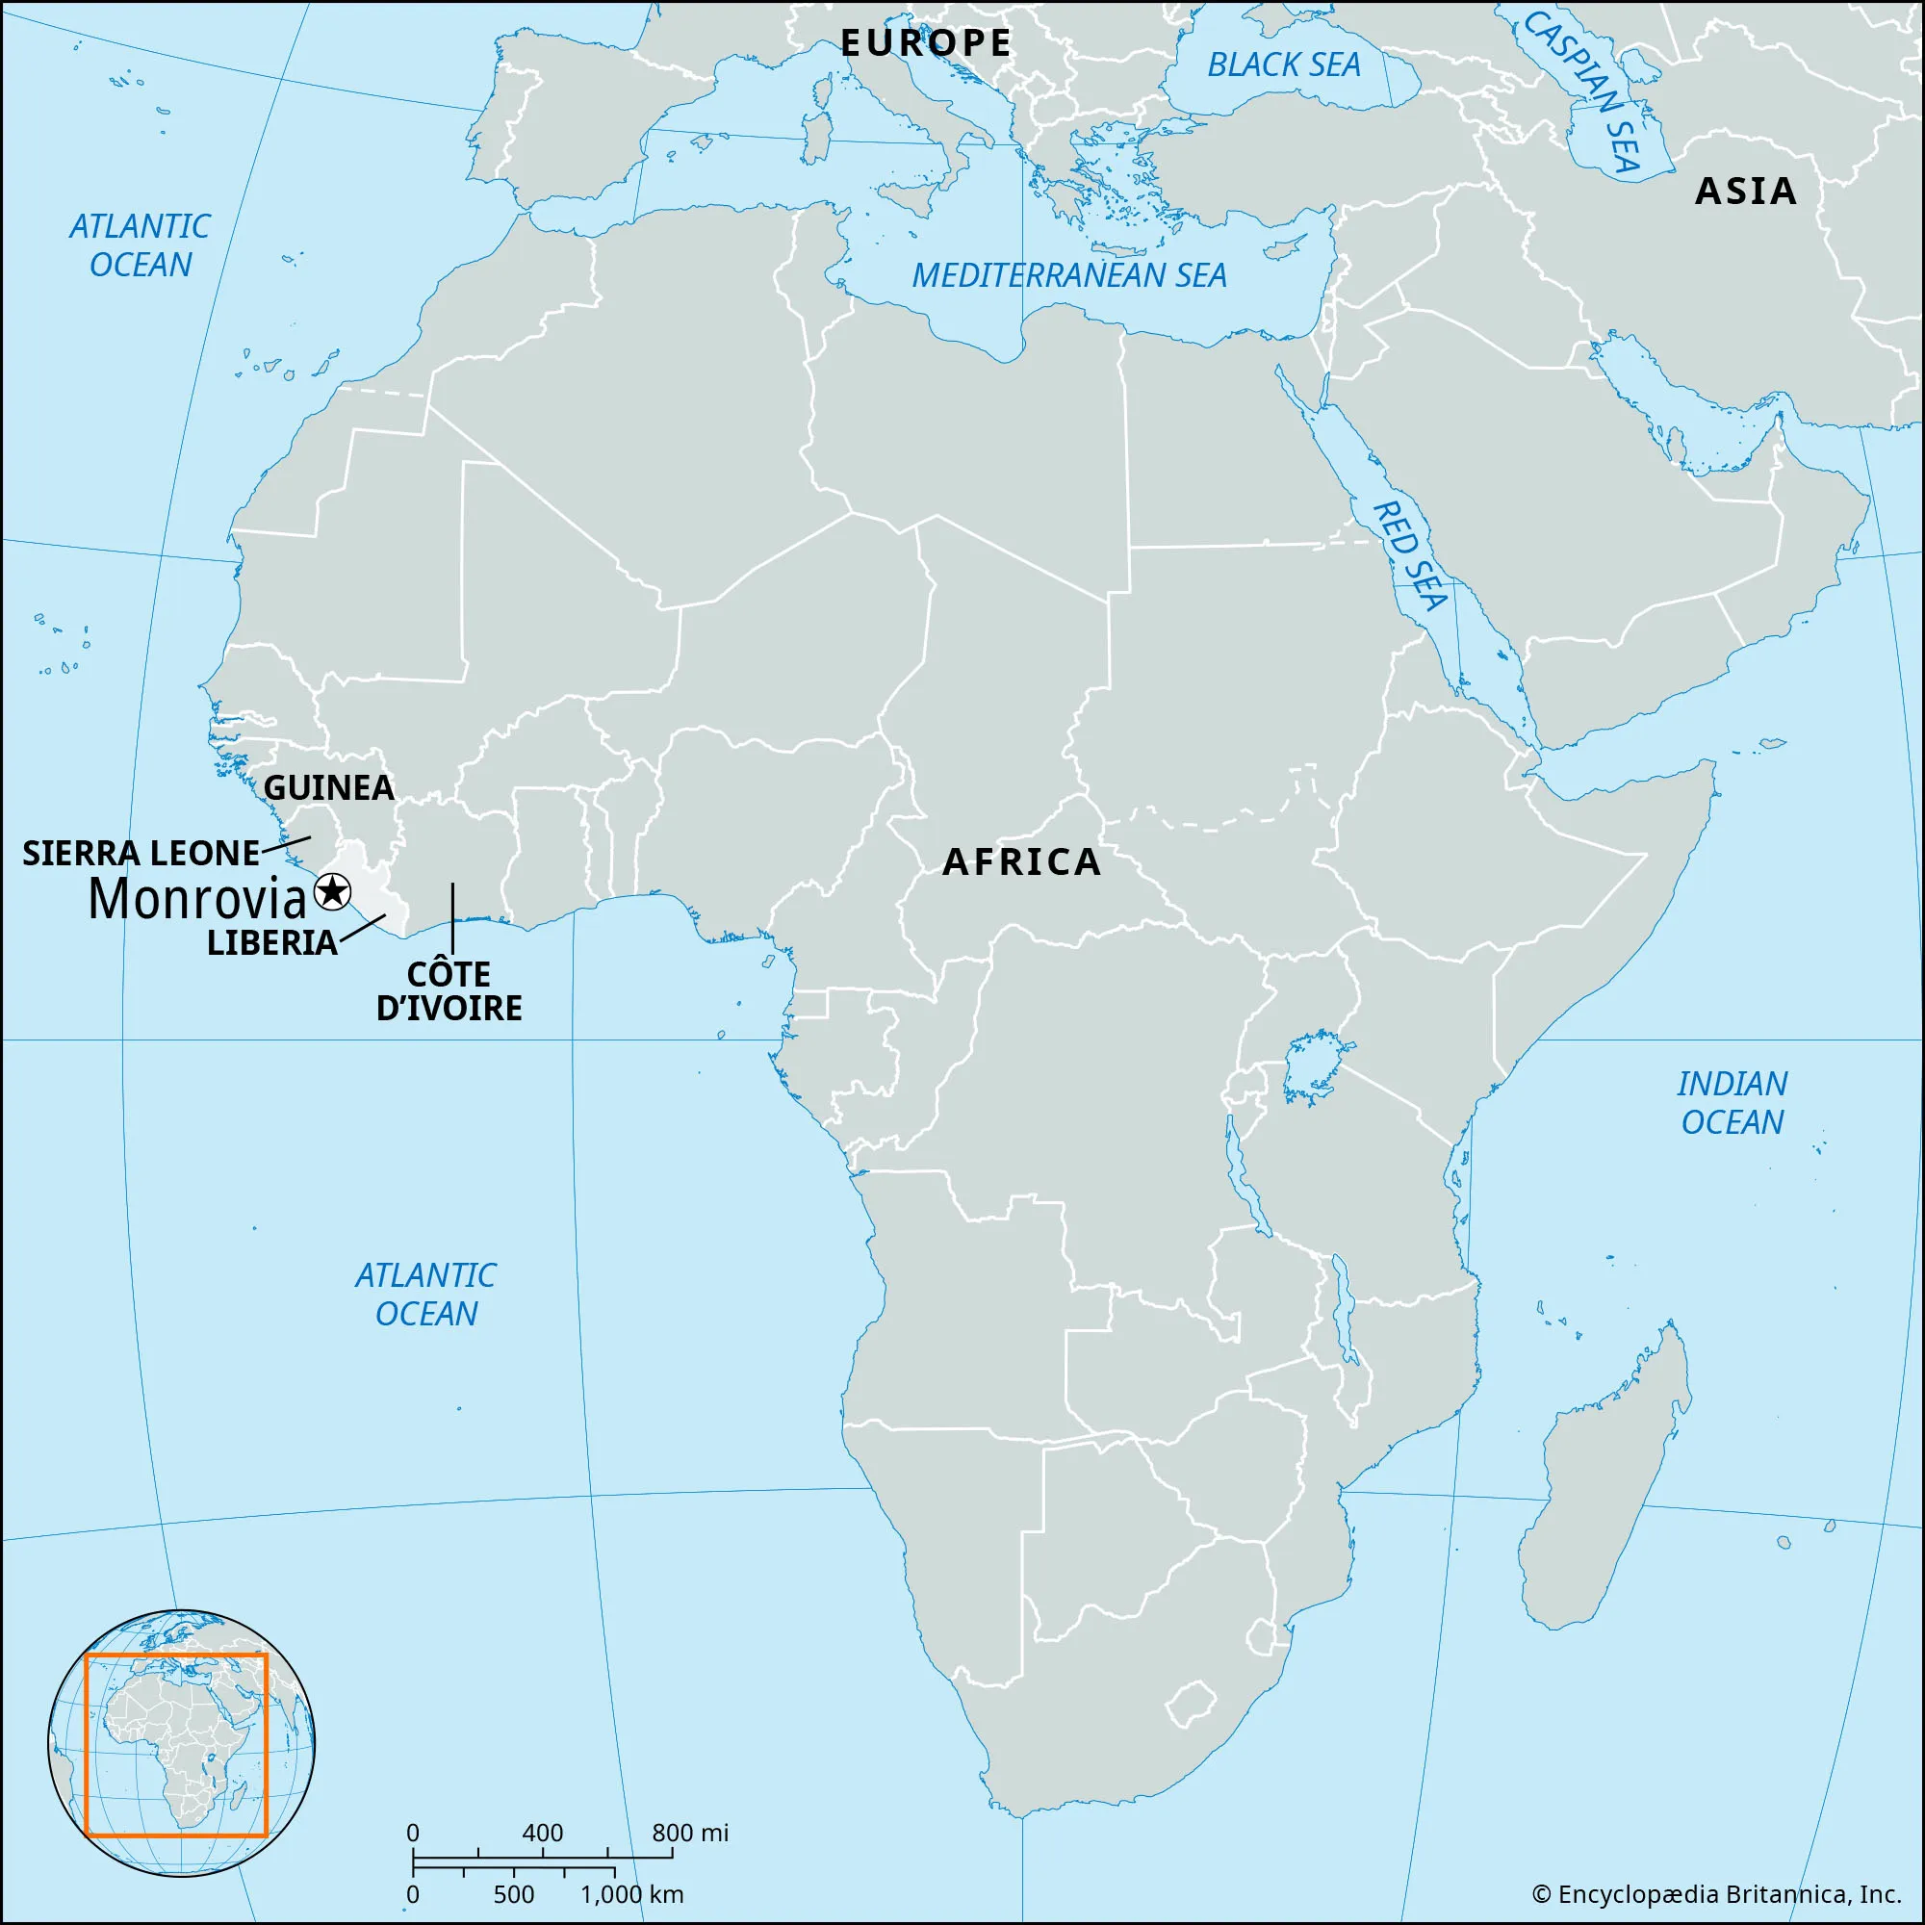
Monrovia, is the Capital City of Liberia. The Capital City is named after the 5th U.S. President
James Monroe.
The 2023 population of Liberia
was 5.2 Million people. Liberia is close in size to the U.S. State of Ohio.

Slide 22
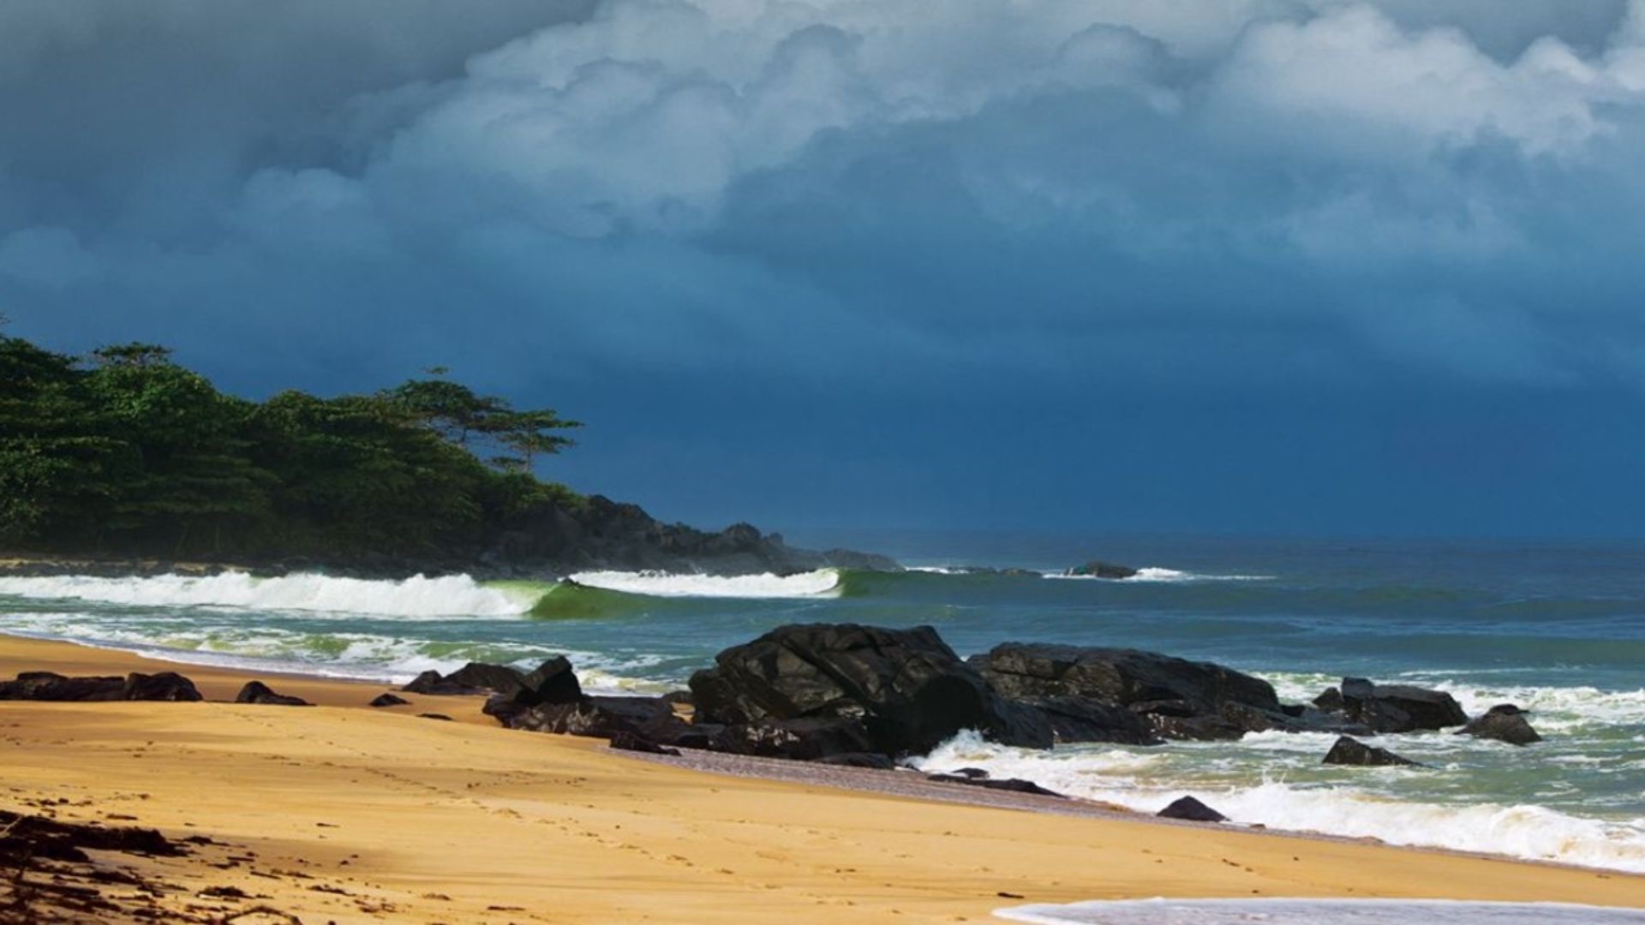
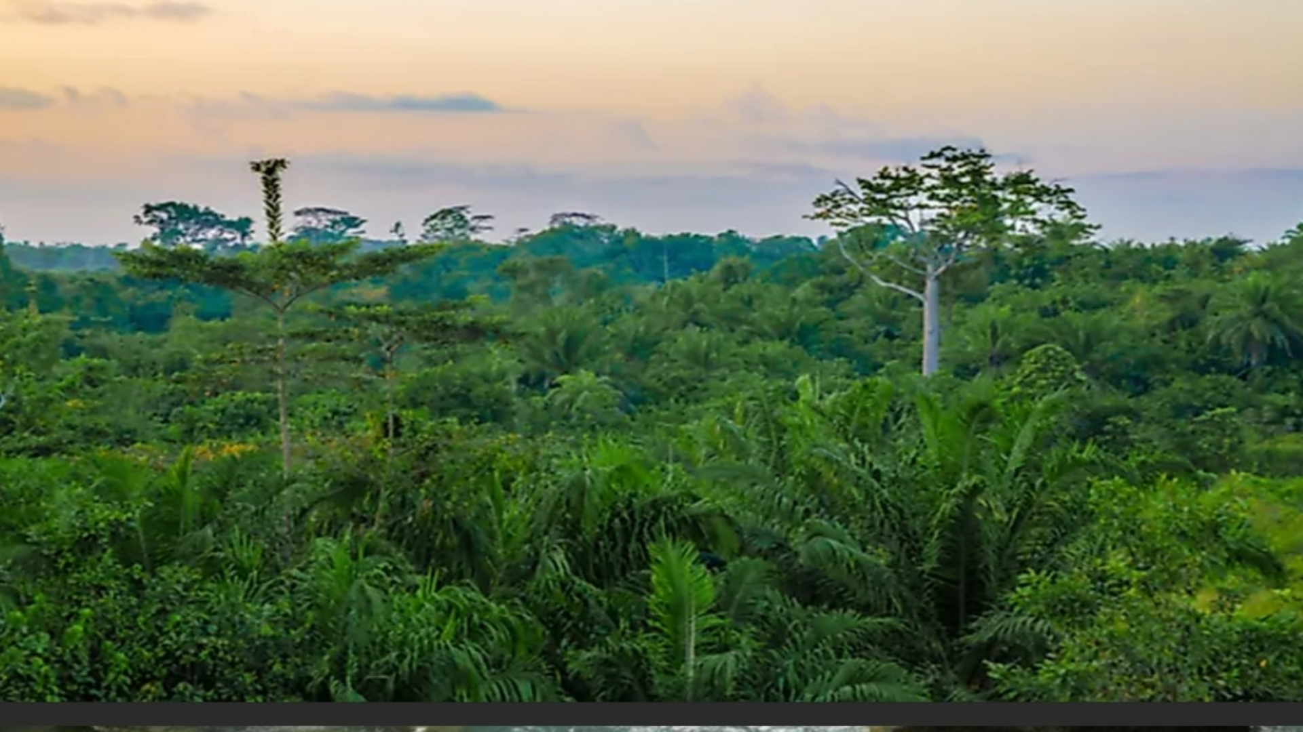
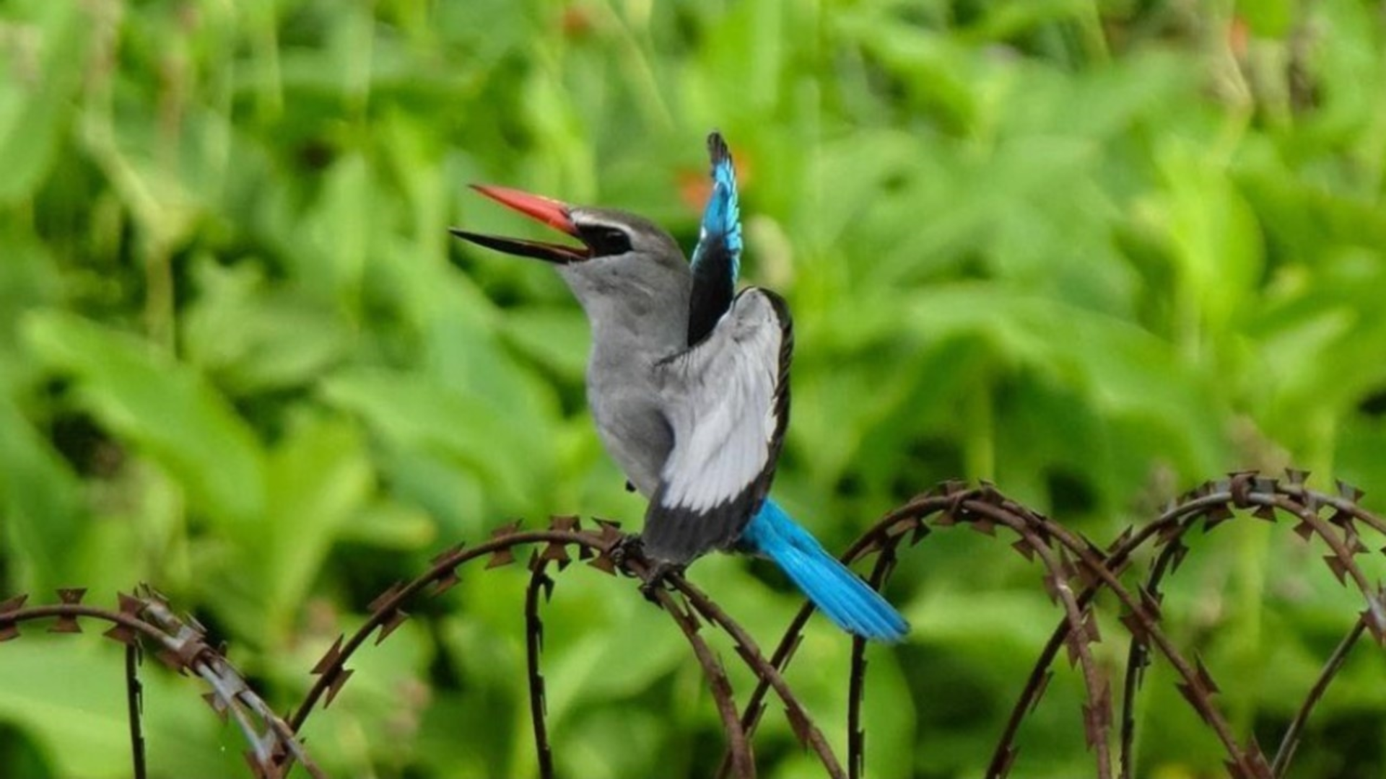
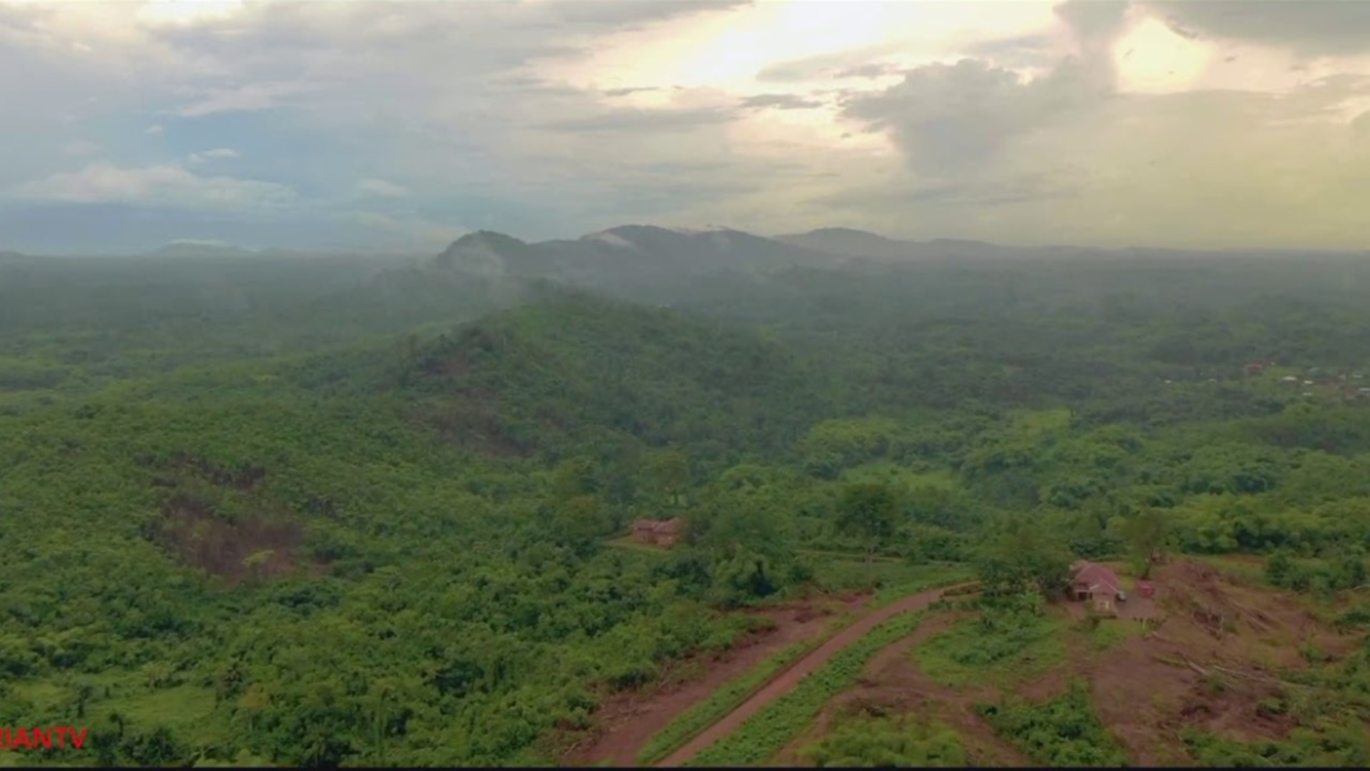

Slide 23
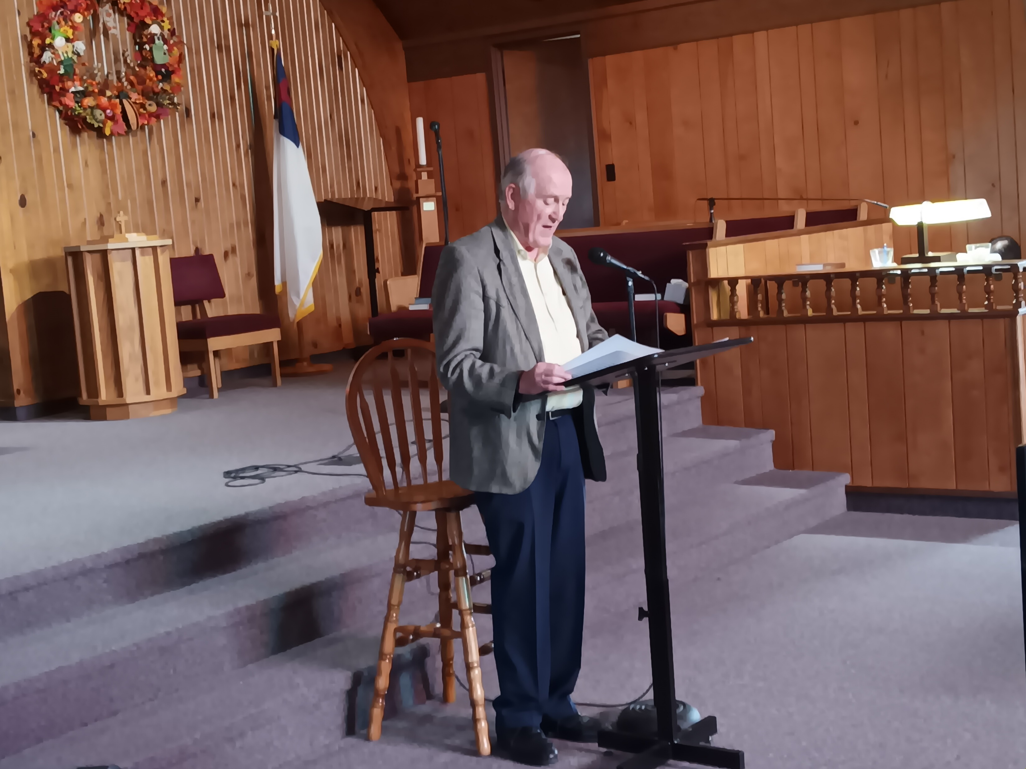
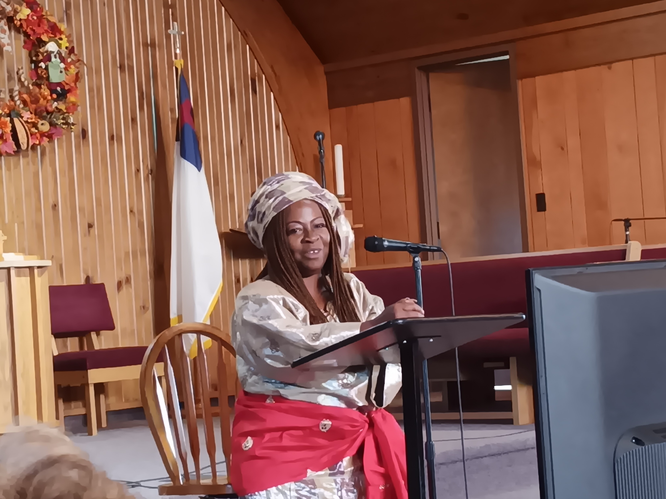
Matilda Wokie Parker’s Speaking & Slide Presentation to all individuals in attendance to the 2023 Peacemaker Event at the Crocker Presbyterian Church on September 27, 2023, at 2:00 p.m.
Pastor Bill Agnew welcoming all of the individuals attending this event which included the introduction of Matilda Parker and Jim and Linda Holt.

Slide 24
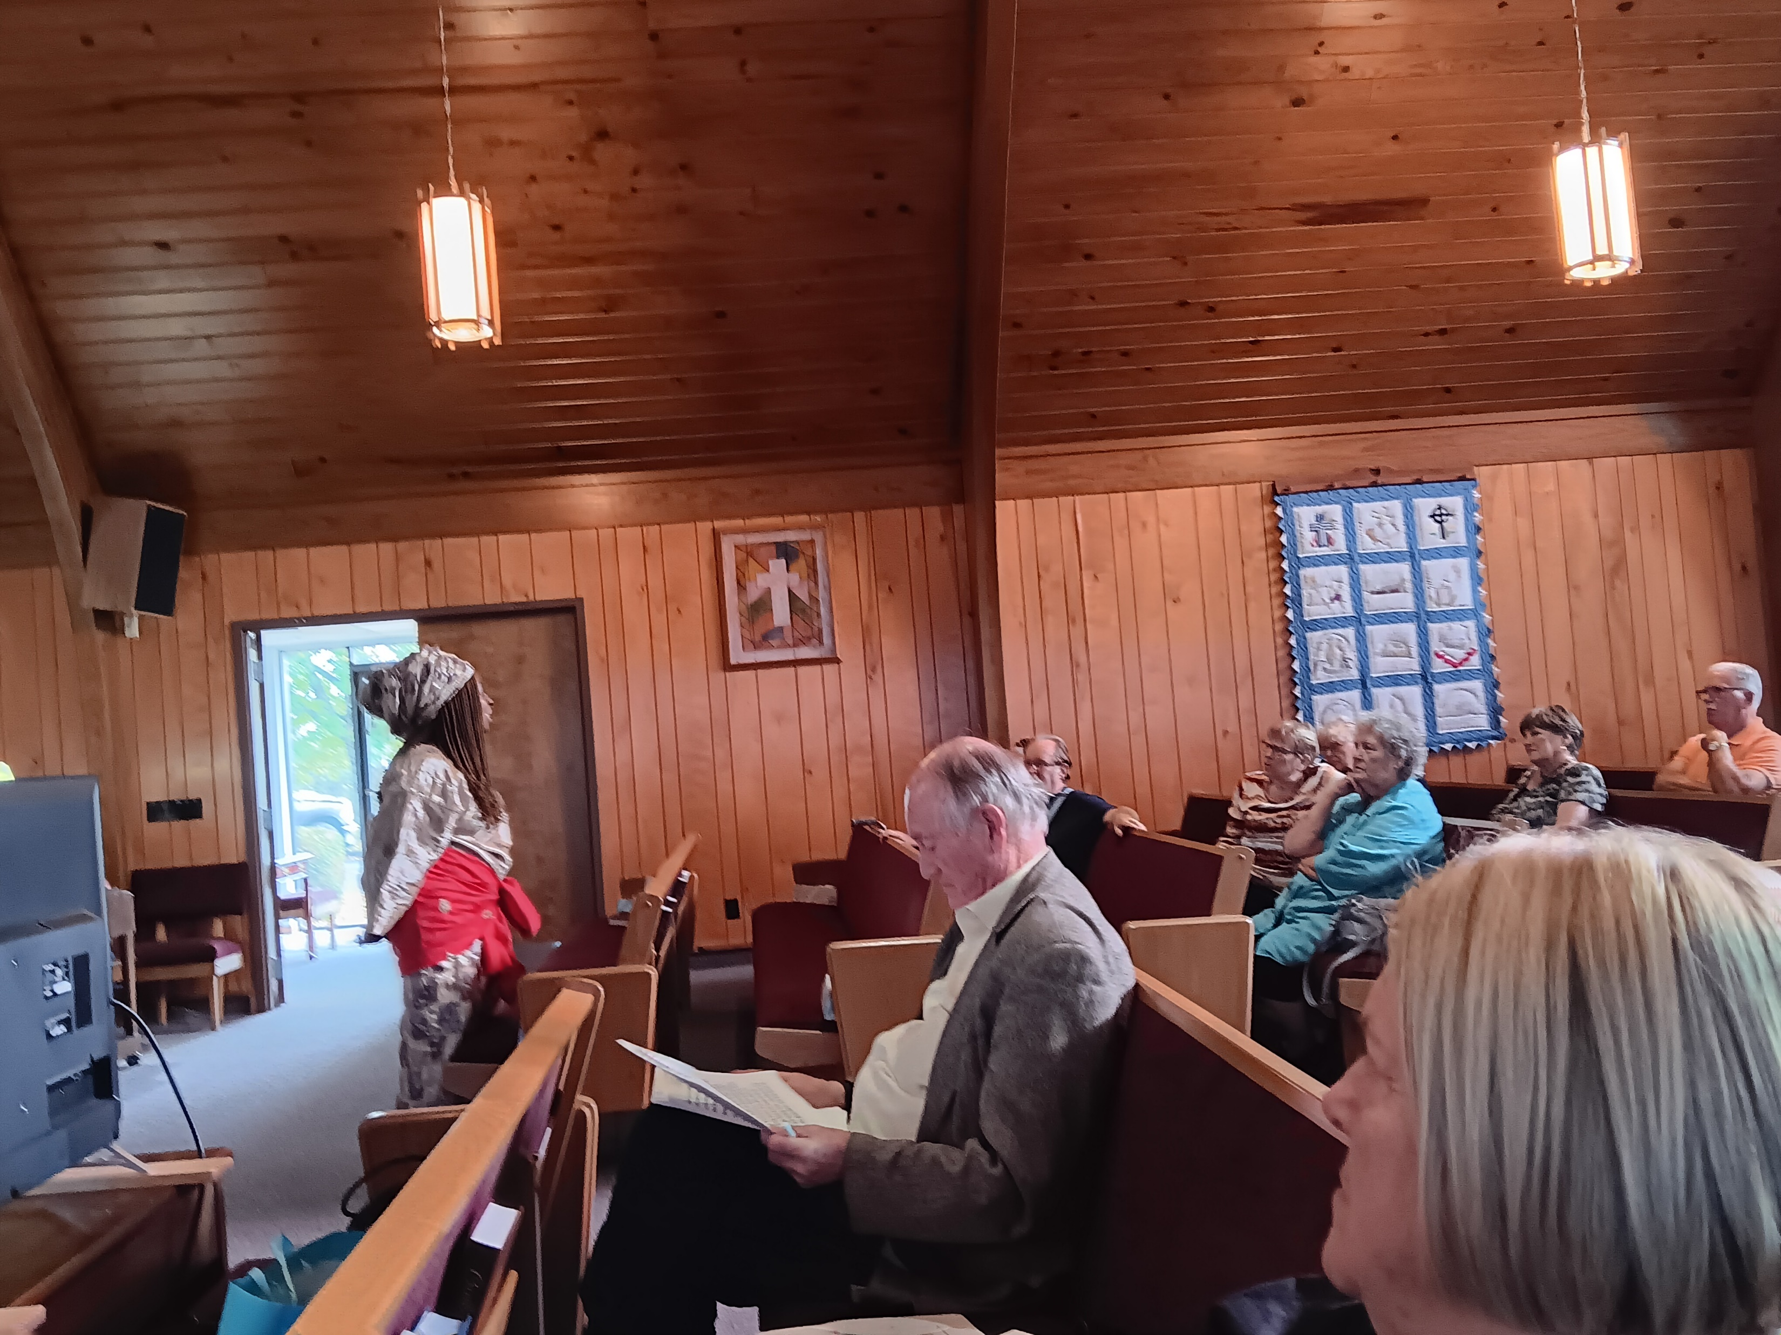
Matilda, answering questions from individuals in attendance following her presentation.

Slide 25
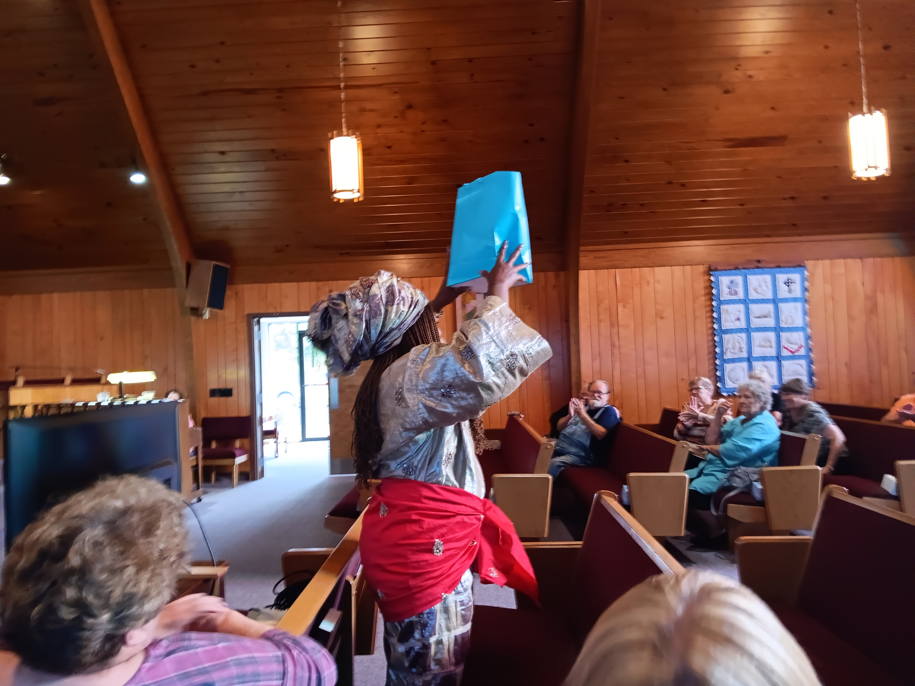
Matilda, receiving gifts from the Crocker Presbyterian Congregation!

Slide 26
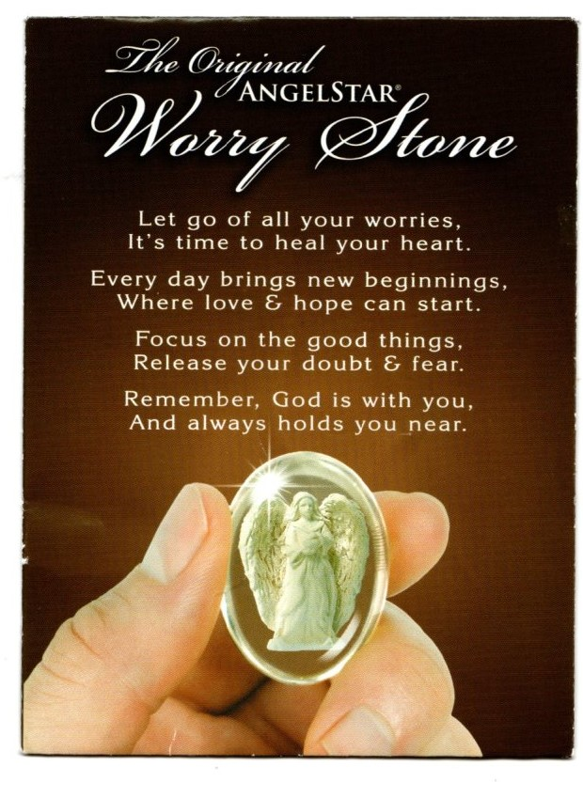
Gift One
Angel Star
Worry Stone
Held When Praying And Reading The Verse.

Slide 27
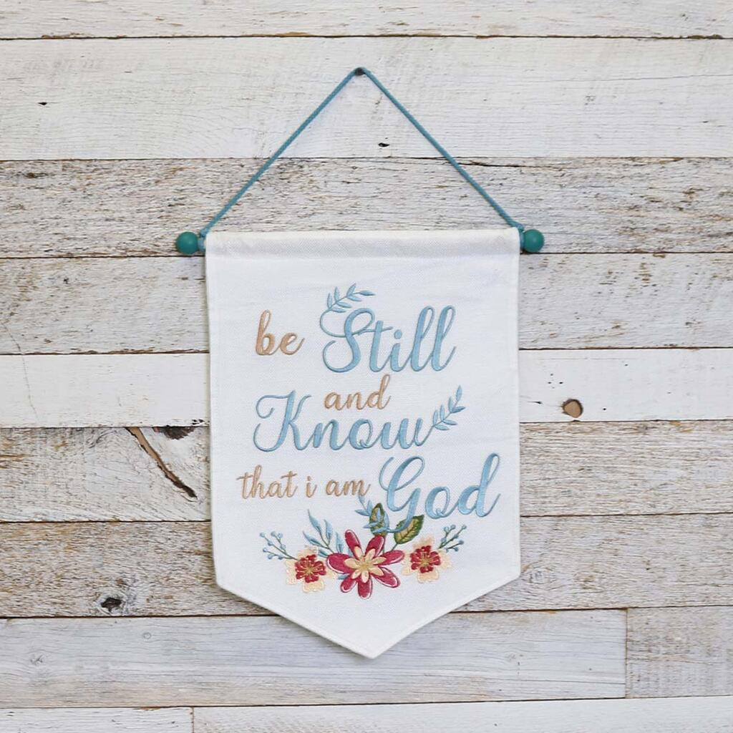
Gift Two
Wall Hanging

Slide 28
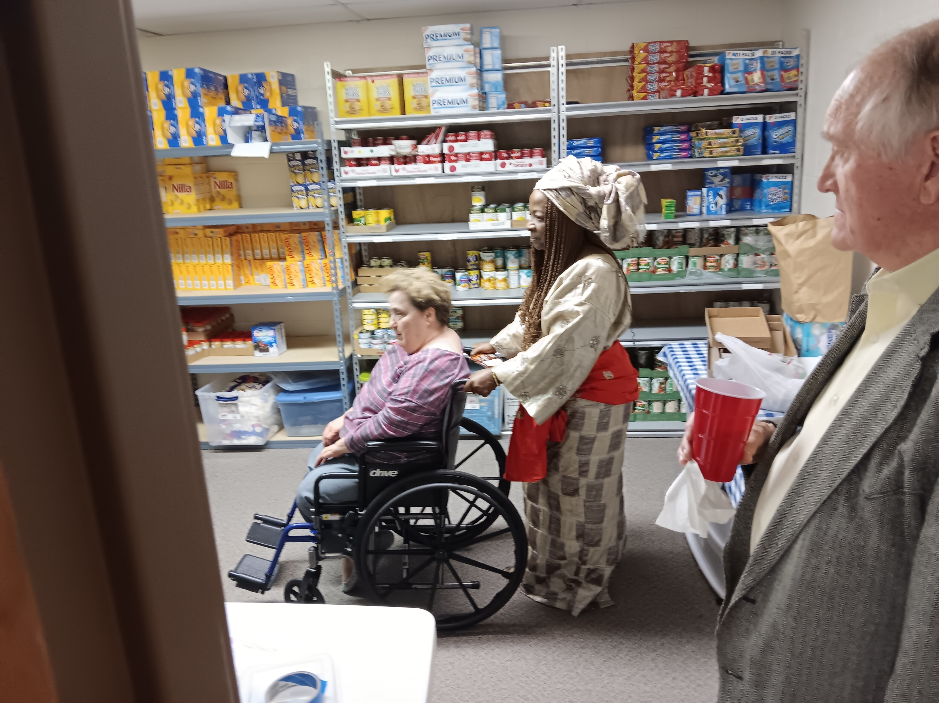
Special Note:
This event proved to be a very special and one that everyone enjoyed greatly. I received many calls from members of the Crocker Community expressing how educational and interesting it was listening to her Peacemaker Presentation. Our Church Congregation will be looking forward to corresponding with her in the future!
Blessing to all those individuals participating in this wonderful and greatly needed event.
Elder Debbie Fraski
Matilda’s Contact Info next screen
Matilda, taking a tour of our Community Food Pantry while graciously pushing me (Debbie Fraski) during the tour.
Thanks Matilda!

Slide 30
Credits
Photos © by Ian Fraski 09/27/2023
Music Blessed Assurance Public Domain
https://www.youtube.com/watch?v=6njRO3-Kieo
Blessed Assurance, Jesus Is Mine Hymn | 1873 - Crosby, Fanny J.V - Blessed assurance, Jesus is mineC - This is my story, this is my song

